Slide 1
The Process of Completing a Biomonitoring eDMR

Slide 2
The Process of completing an eDMR
There are two different websites: one to fill in the eDMR (E2) and one to sign the eDMR (ERS).
E2 address: https://applications.deq.ok.gov/E2
ERS address: https://applications.deq.ok.gov/ERS

Slide 3
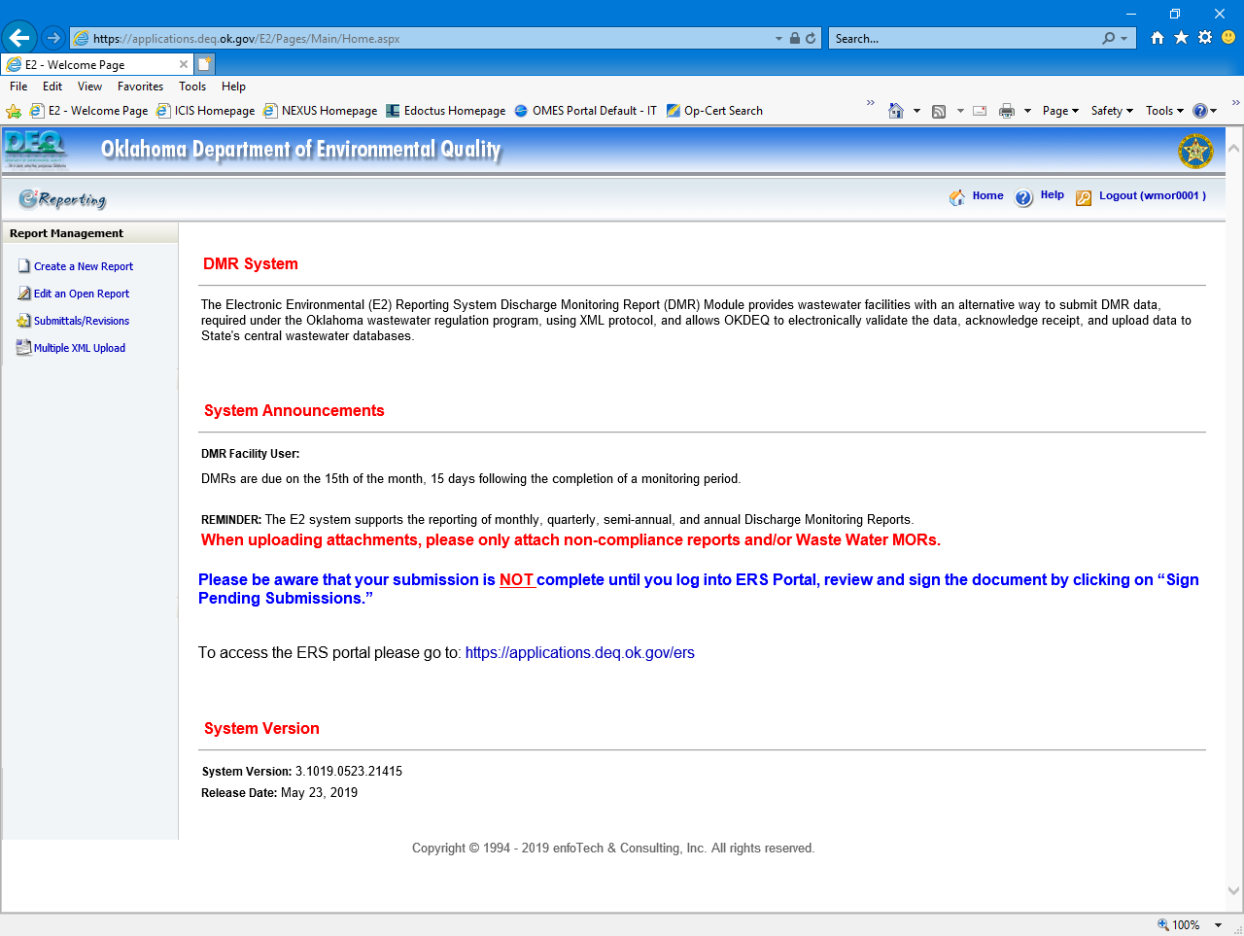
E2: Home Page after Login

Slide 4
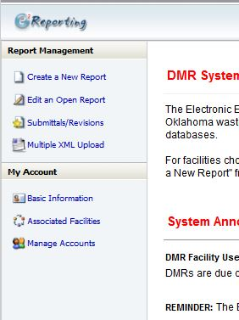
E2: Home Page after Login
Click here to begin the eDMR process

Slide 5
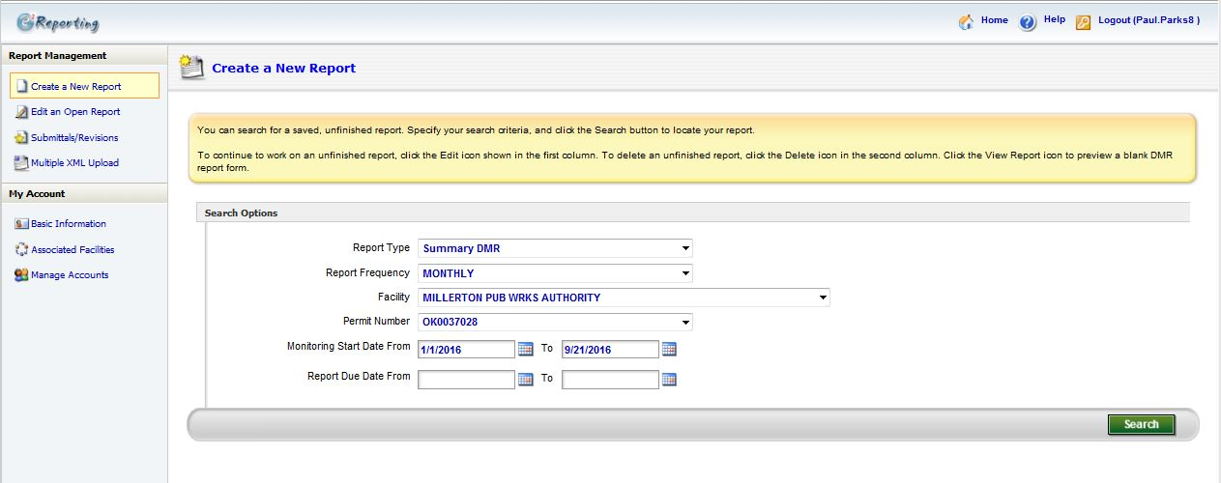
E2: Preparer Create eDMR
Enter Facility Information Here
Instead of monthly, click on quarterly
Enter Monitoring Start and End dates here
Remove any information in these fields

Slide 6
E2: Preparer Create eDMR
Select “Online Entry Form”
Click “Continue”

Slide 7
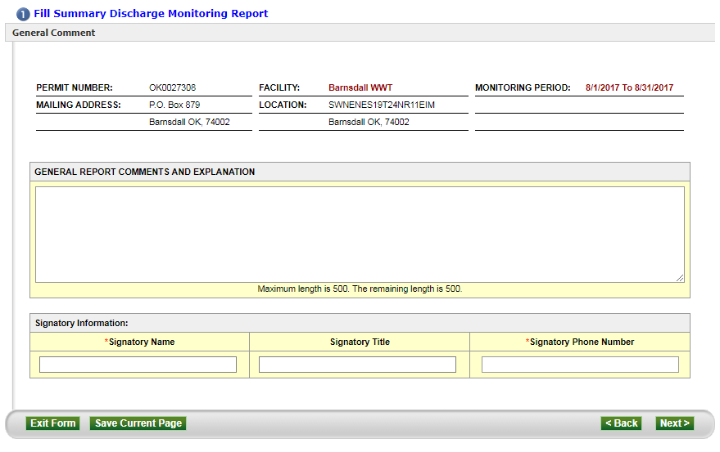
E2: Preparer Create eDMR
Use this field to add any comments you may want (Optional)
Enter the Signatory’s name
Click Next
Enter the Signatory’s phone number

Slide 8
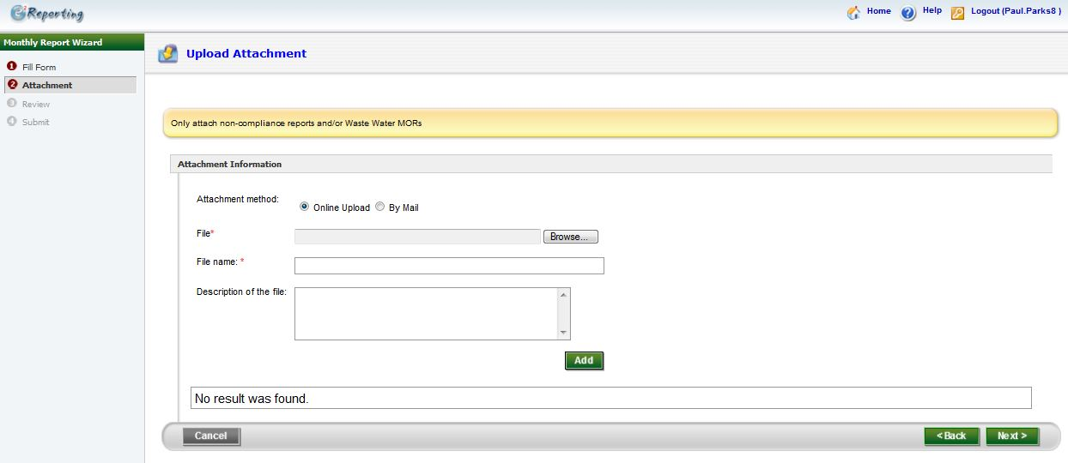
E2: Preparer Create eDMR
This page is optional. If you want to send the lab report here as an attachment.
See slide 52 to send an attachment
Click Next

Slide 9
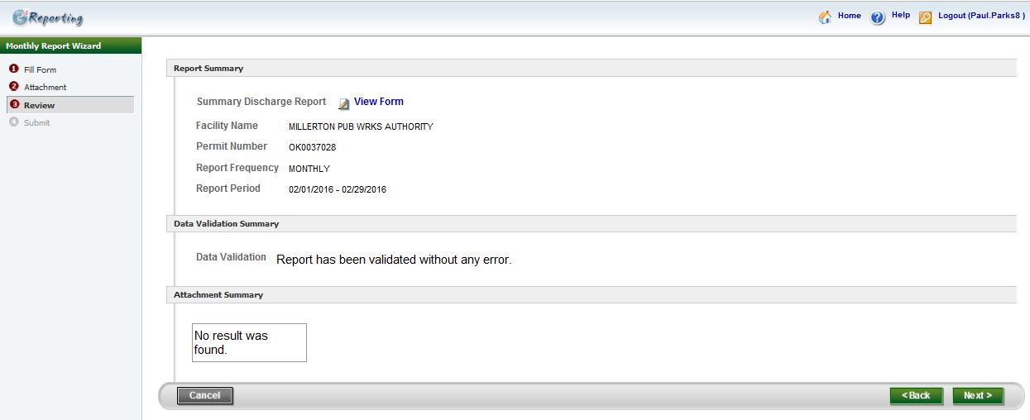
E2: Preparer Create eDMR
Click here to view a copy of the eDMR you will be submitting
Click Next

Slide 10
E2: Preparer Create eDMR
As Preparer you cannot submit the eDMR.
Clicking “Exit” will save the eDMR. Once you have done this, notify the Signatory that the eDMR is ready for review and submittal. Your part is done.

Slide 11
Summary reports
Make sure your laboratory companies send a summary report with the lab reports. It’s the easiest way to take the information from the report to the DMR. Make sure the summary report is easily found in the report.
The facility must keep the lab reports for 5 years at the facility.

Slide 12
Different types of Biomonitoring eDMRs to fill out
Biomonitoring or Toxicity eDMRs are usually quarterly unless the permit says otherwise.
Type 1: Quarterly Biomonitoring eDMR
Type 2: Semi-annual Biomonitoring eDMR-The facility has to apply for this and it has requirements what months to test for during the monitoring period.

Slide 13
Different types of Biomonitoring Testing
Type 1: Acute Biomonitoring – Point Estimation (Acute lethal concentration - LC 50)
Type 2: Chronic Biomonitoring – Significant Difference (Chronic No observed Effect level-NOEC)

Slide 14
Concurrent Testing- Ammonia & ph
2 NH₃ & pH Analyses per sample
All municipalities must do…
Most industries do not do.

Slide 15
If you have no discharge do you still have to send in the eDMR?
YES

Slide 16
PROCESS FLOW FOR WET DMRs AND LAB REPORTS
1. WET DMRs received by Enforcement Coordinators (ECs) electronically.
2. DMR is received electronically. WET lab report is included or submitted by email or snail mail.
3. DMRs and lab reports are due the 15th of the month following the month the test was conducted.
4. A violation (SNC) is triggered if DMR has not been received by 45 days after the end of the mon period.….
“No shows” get a call from EC.

Slide 17
PROCESS FLOW FOR WET DMRs AND LAB REPORTS continued
5. Review of DMRs and Lab Reports by the Biomonitoring Coordinator (“BC”):
a. Incorrect DMRs have to be resubmitted as a "revised DMR“.
b. Invalid tests require another test to be run which are “repeat tests”.
c. If a failure of a WET test occurs, a “Retest” is required.
d. One retest failure triggers a TRE (non-WET limit permits). WET LIMIT permits have 6 months to pass 3 in a row.
e. If TRE is triggered a TRE plan must be submitted. TRE plan is due 90 days after retest failure, first quarterly report is due 30 days after plan due date, 7 more quarterly reports and then final report due 30 days after 8th quarterly report and late 90 days after 8th report is due (lasts 28 months or until toxicity is confirmed via EPA protocol)
Arrival dates of TRE plan/quarterly/final reports are tracked by EC and in ICIS.
TRE progress is monitored by the BC, report deadlines by the EC

Slide 18
PROCESS FLOW FOR WET DMRs AND LAB REPORTS continued
6. Retest results are entered into ICIS and tracked by BC in a Retest Summary Log ….
a. Non Wet Limit permits report Retest #1 “22415” or Retest #2 “22416” via associated quarterly DMR.
b. ICIS accommodates 2 retests, BC tracks these in a log. For WET limit permits, a TX1-A DMR (with one month monitoring period) is submitted.
c. The lab report goes to the BC for review.
d. BC logs all retest results and TRE progress.

Slide 19
Acute Wet Test Protocol
Test Type: 48 hr Acute Static Renewal
EPA Methodology: EPA-821-R-02-012
Dilutions of effluent: 32%, 42%, 56%, 75%, and 100 %
Effluent Sampling: Two 24-hour composite Samples (6°C)
Effluent Sample Age: < 36 hrs from end of 24 hr cycle
Control Sample: Dilution Water + Test organisms
# of Replicates: 5 per dilution
# of Organisms: 8 per replicate
Organisms: D. pulex and P. promelas
Organism Age: <14 days old. No feeding during Test

Slide 20
Calculating the analytical portion of the biomonitoring dmr
Concurrent ammonia & pH
2 samples per composite (lab sample goes on DMR)
Sample 1 Sample 2
Example: pH 7.5 7.3
Ammonia 3.2 3.8
Minimum Maximum
Report for pH on eDMR: 7.3 7.5
Minimum Average Maximum
Report for ammonia on eDMR: 3.2 (3.2 + 3.8)/2 = 3.5 3.8

Slide 21
Retest 1 and 2
If the original test passed, use *9 on both retest 1 and retest 2. Do not use zero (0).
If the original test failed, retest 1 and 2 should be either zero (0) for a pass retest or one (1) for a failed test. For eDMR purpose, the facility will need to revise the DMR through the E2 website and resign the DMR through the ERS website.
To learn how to revise a eDMR, follow this link https://www.deq.ok.gov/water-quality-division/electronic-reporting/ . Click on the Wastewater Discharge Monitoring Reports and then click on How to Revise an eDMR.

Slide 22
How to start to figure the Acute Testing
LC 50: Concentration of effluent that is lethal to 50% of test organisms
Pass = >100 % effluent
Fail = < 100 % or equal to 100 effluent
If < 50 % die in 100 % effluent, LC50 = >100 % = Pass
If 50 % die in 100 % effluent, LC50 = 100% = Fail
If >50 % die in 100 % effluent, LC <100 % = Fail

Slide 23
Storet Codes
TAM3D = Survival 48 hr Acute D. pulex = reported in percentage (%)
TAM6C = Survival 48 hr Acute P. pimephales (Fatheads) = reported in percentage (%)
TIM3D = Pass/ Fail Survival Acute D. pulex = anything equal to or less than 100% (fail = 1) otherwise report “0” for pass
TIM6C = Pass/ Fail Survival Acute P. pimephales (Fatheads) = anything equal to or less than 100% (fail = 1) otherwise report “0” for pass If you failed, the excursion will be 1 on the storet code that you failed.

Slide 24
Storet Codes
TJM3D = % of mortality of D. pulex in 48 hr period at 100% dilution = report in percentage (%)
TJM6C = % of mortality of P. pimephales at 100% diluation = Report in percentages (%)
There is no excursions of TJM3D or TJM6C
Whole Effluent Toxicity Limit (WET Limit) = >100 (pass) or 100 (failed) or <100 (failed)

Slide 25
Examples
Acute test example 1:
pH samples = sample 1= 7.54 sample 2 = 8.34
2 concurrent ammonia samples: sample 1= <0.2 sample 2 = <0.2
WET Limit = >100%
TAM3D = LC50 48 hr Acute D. pulex = >100%
TAM6C = LC50 48 hr Acute P. pimephales (Fatheads) = >100%
TIM3D = >100% SURVIVAL = 0
TIM6C = >100% SURVIVAL = 0
% Mortality for D. pulex = 0 %
% Mortality of fathead minnows = 0%

Slide 26
Example 1 continued

Slide 27
Example 1 continued

Slide 28
Is this DMR correct?

Slide 29
Answer = no
What is wrong with this DMR?

Slide 30
Should be <0.2 for all 3
Should be > 100
Should be >100
Should be >100

Slide 31
Example 2 with Lab Report

Slide 32
Example 2 with Lab Report

Slide 33
Example 2 with Lab Report
pH minimum = 7.78 pH maximum = 8.17
Ammonia minimum = <0.36 Ammonia average = <0.36 Ammonia maximum = <0.36
WET Limit = > 100
TAM3D = >100
TAM6C = >100
TIM3D = 0
TIM6C = 0
TJM3D = 0%
TJM6C = 5%

Slide 36
Chronic Biomonitoring DMR
Test Type: Chronic Static Renewal
EPA Methodology: EPA-821-R-02-012
Dilutions of effluent: 32%, 42%, 56%, 75%, and 100 % (varies with Critical Dilution)
Effluent Sampling: three 24-hour flow-proportional composite Samples (6°C)
Effluent Sample Age: < 36 hrs from end of sampling cycle
Control Sample: Dilution Water + Test organisms
Organisms: C. dubia, P. promelas, and D. magna
Organism Age: <24 hrs old / in-house or outside sourced

Slide 37
Storet Codes for chronic test
TLP6C = Fathead Lethality = Pass (0) / Fail (1)
TLP3B = C. dubia Lethality = Pass (0) / Fail (1)
TGP6C = Fathead Sublethality = Pass (0) / Fail (1)
TGP3B = C. dubia Sublethality = Pass (0) / Fail (1)
TOP6C = Lethal NOEC fatheads = %
TPP6C = Sub-lethal NOEC fatheads = %
TOP3B = Lethal NOEC C. dubia = %
TPP3B = Sub-lethal NOEC C. dubia = %

Slide 38
Storet Codes for chronic test
TJP6C = FH Mortality Critical Dilution = %
TJP3C = C. dubia Mortality Cr Dilution = %
TQP6C = Highest Coefficient of Var (CV) = %
(Cr Dil or Control, Survival or Growth)
TQP3B = Highest Coefficient of Var (CV) = %
(Cr Dil or Control, Survival or Growth)
22415 #1 = Retest #1 = Pass (0) / Fail (1)
22416 #2 = Retest #2 = Pass (0) / Fail (1)

Slide 39
Example 1 with lab report
Maximum ammonia
Minimum pH
Minimum ammonia
Ammonia average = (<0.10 + <0.10 +0.14) /3= <0.11
Maximum pH

Slide 40
Example 1 with lab report- C. dubia survival and reproduction test
90% survived 10% mortality (TJP3B)
TGP3B = Pass (0)
TLP3B = Pass (0)
TGP3B = 22.7
TOP3B and TPP3B = 100%
TJP3B =10

Slide 41
Example 1 with lab report- Fathead Minnows survival
Choose the highest between Control and 100% diluation, which is 18.6

Slide 42
Example 1 with lab report- Fathead Minnows survival
TJP6C = 100 – 62.5 = 37.5

Slide 43
Example 1 with lab report- Fathead Minnows survival and growth
TGP6C = failed (1)
TLP6C = failed (1)
TOP6C and TPP6C = 32%
TQP6C = 18.56
TJP6C = 37.5

Slide 44
Chronic Test dmr
This should be <0.11
Excursion is correct

Slide 45
Chronic Test dmr
Excursion is correct

Slide 46
Chronic Test dmr

Slide 47
What to do with an Invalid test
An invalid test is defined as any test which does not satisfy the test acceptable criteria, procedures , and quality assurance requirements specified in the test methods and permit.
Should we use these results in calculations for the eDMR?
NO! Because they didn’t pass QC. NODI code *H is used for invalid test and a repeat test should be performed. If repeat test is not performed, the test will result in a significant non-compliance (SNC) category 1 violation. A Notice of Violation (NOV) letter will follow.

Slide 48
How do we report exceedances?
Number of Exceedance – Only WET limit and pass or fail storet codes have excursions. The rest of the storet codes use (0). If the storet code is 1 then the excursion is 1. The Excursion is never more than one on the Biomonitoring DMRs
On the eDMR, it is shown as NO. EX……this is not how many times you sampled. That column is the FREQUENCY OF ANALYSIS.

Slide 49
Lab Report requirements-Part II in the permit
4. Reporting
a. The Permittee shall provide a full laboratory report of the results of all test conducted pursuant to this section in accordance with the Report Preparation Section of EPA-821-R-02-012 for every valid or invalid toxicity test initiated, whether carried to completion or not, including any test which is considered invalid, is terminated early for any reason, or which indicates receiving water toxicity. The Permittee shall retain each full report pursuant to the records retention provisions of Part III of this permit. The permittee shall submit to DEQ full laboratory test reports for all test initiated, regardless of whether the test are carried to completion. The reports shall be postmarked or received no later than the 15th day of the month following completion of the test.

Slide 50
Lab Report requirements
Facilities must send in the lab reports into DEQ. All test include repeat and retest must send in lab reports. Failure to send in the report will result in Notice of Violation (NOV).
Two options to send in the lab report:
Option #1: Send through the E2 website as an attachment.
Option #2: Send through email to the Biomonitoring Coordinator

Slide 51
E2- lab report attachment
This is where to send the attachment of the lab report with the DMR. Some lab reports are too big to send. Send through BC’s email if that is the case.
Click on the browse and search where the file is on your computer. Once you hit the file, the file name will appear here
Hit Add to complete the download. Then Click next.

Slide 52
Any Questions ask the biomonitoring coordinator
Bob Battles- email: Robert.Battles@deq.ok.gov Phone number: 405-702-8201

