Slide 1
Reducing the Rate of NPDES SNC at State Facilities

Slide 2
Why we have to reduce SNC facilities in the state of Oklahoma……EPA’s new objective

Slide 3
EPA’s two types of SNC noncompliance
Category 1: A) Reporting Violations. Includes Non-submit eDMR, Non-sampling, effluent limits, final compliance schedule progress reports, construction violations, compliance schedule violations
Category 2: All other types of noncompliance that do not meet category 1

Slide 4
What is a significant noncompliance violation (SNC) on your eDMR
Three types of SNC eDMR: effluent violations, non-sampling violation, and non-submit violations
What is the most common SNC violation?

Slide 5
Answer: non-submit of DMrs
Non-submit is 64% of SNC rate nationwide, most of that is incomplete data

Slide 6
SNC color code:

Slide 7
SNC rate

Slide 8
What’s the violation that an operator’s can control the most?

Slide 9
ANSWER: Non-submit and non-sampling
Documentation of your day-to day operations (MORs, permit on site, and SOP)
What you have to sample for and when you have to sample (permit requirements)
Calibration of lab equipment
Your wastewater and water license
Filling out eDMRs properly

Slide 10
Common Causes of SNC at State Facilities Continued
Lack of communication between facilities and ODEQ
Not getting the permit to the operators
Not reading the permit
Lack of organization within the Town or City

Slide 11
Common Causes of SNC at State Facilities
Lack of Qualified Operators
High turn-over of trained staff
Lack of financial resources-Biggest problem among small facilities
Lack of adequate training- Because of the financial difficulties
Lack of Standard Operating Procedures-permit on site, MORs on site, laboratory paperwork on site, day to day to do list, lab equipment paperwork on site
Lack of computer skills

Slide 12
Oklahoma DEQ Strategies to Address State Facility SNC
Reminder emails 5 days prior to due date to State Permitted Facilities
Follow-up calls
Data fixes for E2
Send Warning emails to 10 days after due date to avoid formal enforcement action
Identify State Facilities in SNC for regions & provide justifications for follow-up action (Notice of Violations)

Slide 13
Strategies Continued
To provide training on how to fill out eDMRs and operational training
Develop a better way to communicate with facilities (emails or phone calls

Slide 14
Epas new tool ECHO. Who can see this data…everybody

Slide 19
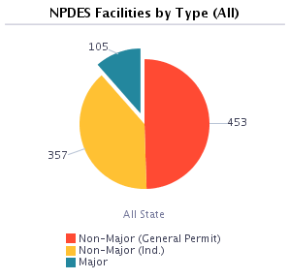
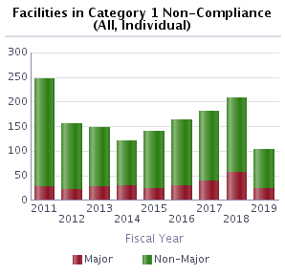
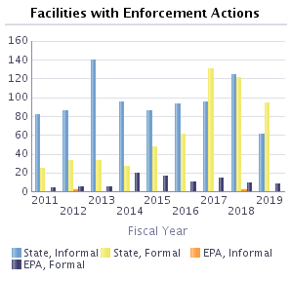
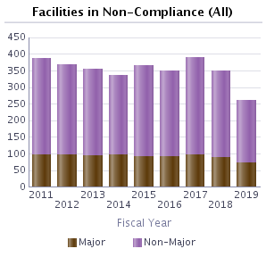

Slide 20
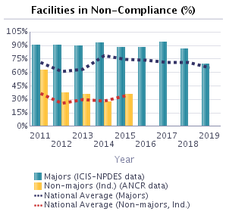
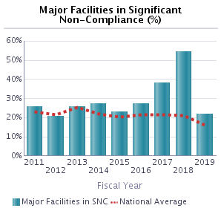
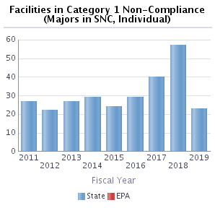
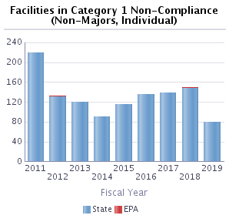
Percentages calculated from EPA's data system (ICIS-NPDES)
for major facilities on a fiscal year basis and ANCR data for
non-major facilities on a calendar year basis. Only state
violation determination data on major permittees is required to
be shared with EPA. ANCR data are available for 2011 - 2015.

Slide 21
Oklahoma compared to the Regional level

Slide 22
The Process of completing an eDMR
There are two different websites: one is to fill in the DMR (E2) and one to sign the eDMR.

Slide 23
How to start to figure the calculations for the eDMR
We recognize that calendar weeks and calendar months rarely coincide. There for the purpose of calculating and reporting 7-day averages you should follow this process
If you are a weekly tester, you need to define your week and stick with it
Sunday- Saturday or Monday-Sunday etc
For Monthly testers, calculate everything that falls in that month

Slide 24
What to do with a Invalid test
An invalid test is defined as any test which does not satisfy the test acceptable criteria, procedures , and quality assurance requirements specified in the test methods and permit.
Should we use these results in calculations for the eDMR?

Slide 25
What to do we do with a test results that are below detectable limits
Unless otherwise stated in the permit, values below the detection limit are to be reported with a less than symbol ( < ) and the numeric value for the detection limit using the EPA approved method.
Where the permit contains a listing of Minimum Quantification Levels (MQLs) and the
permittee is granted authority in the permit to report zero in lieu of the <MQL for a specified parameter, (conventional, priority pollutants, metals, etc.) then zero is to be reported for that parameter.
In some cases the permittee has been granted by letter the authority to report zero when the permit does not contain this language. The permittee may request this authorization from its regulatory agency.

Slide 26
How do we report exceedences
Number of Exceedance - Total of sample measurements that exceed the daily maximum, daily minimum, or 7-day (weekly) average permit limit. DO NOT include monthly average or daily average violations in this field. If none, enter “0". Permittees with continuous pH, or temperature monitoring requirements should consult the permit for what constitutes an accedence and report accordingly.

Slide 27
How do we calculate loadings
In order to calculate loading we use the formula
Sample result X 8.34 X Flow of the day the sample was took

Slide 28
How do we calculate geometric mean
For samples that have a value of TNTC on a plate count, the value must be 60000 / 100 mL for calculating the geometric mean. Never put “TNTC” for the geometric mean
For samples that have a value of “0 colonies” on a plate count, the value must be 1 / 100 mL for calculating the geometric mean. Never put “0” for the geometric mean
In order to calculate geometric mean we use 2 formulas
Method 1: Geometric Mean = “nth” root of n1 x n2 x n3 Example: 1 X 150 =150 of 2nd root = 12.2
Method 2: is the average sum of the logs (log n1 + log n2...) followed by the anti-log of the average Example: log 1 + log 150 = 0 + 2.176 = 2.176 / 2 = 1.088 = inv log 1. 088 = 12.2

Slide 29
Examples of calculating the geometric mean
Sample 1: TNTC
Sample 2: 300
Sample 3: 150
Sample 4: BPQL
Method 1: 60000 x 300 x 150 x 1=
Method 2: log 60000 + log 300 + log 150 + log 1= 4.77 + 2.47 + 2.17 + 0= 9.41
Inv. Log 9.41= 227.95

Slide 30
Is there a difference between facilities that test 3 times a month compared to 3 times a week?

Slide 31
YES
Why?
Calculations are different. Instead of taking the monthly average, weekly average is used. Example for weekly average
Week 1: (Sample 1 + Sample 2 + Sample 3)/3 = average week 1
Week 2: (Sample 1 + Sample 2 + Sample 3)/3 = average week 2
Week 3: (Sample 1 + Sample 2 + Sample 3)/3 = average week 2
Week 4: (Sample 1 + Sample 2 + Sample 3)/3 = average week 2
Monthly Weekly Average = (Avg. week 1 + Avg. week 2 + Avg. week 3 + Avg. week 4) / 4
Maximum Weekly Average = the highest of the 4 average weeks

Slide 32
Example 1 for facilities that test 2 per month
BOD sample Result Flow of the day of the sample in MGD
1 BPQL 0.36
2 45 0.57
BOD’s BPQL is 2.0 mg/l Monthly Average: (<2.0 + 45)/2= <23.5 Maximum: 45
BOD Loading Calculations: Sample 1: 2.0 X 8.34 X 0.36= <6.0 Sample 2: 45 X 8.34 X 0.57= 213.92
BOD Monthly Loading Average : (<6.0 + 213.92)/2= <109.96
What it should look like on the eDMR
Loading (Limit is 45) Monthly Average (Limit is 30) Maximum (Limit is 45) No. Ex
BOD <109.96 <23.5 45 0

Slide 33
Example 2
BOD sample Result Flow of the day of the sample in MGD
1 BPQL 0.36
2 65 0.57
BOD’s BPQL is 2.0 mg/l Monthly Average: (<2.0 + 65)/2= <33.5 Maximum: 65
BOD Loading Calculations: Sample 1: <2.0 X 8.34 X 0.36= <6.0 Sample 2: 65 X 8.34 X 0.57= 308.99
BOD Monthly Loading Average : (<6.0 + 308.99)/2= <157.49
What it should look like on the eDMR
Loading (Limit is 45) Monthly Average (Limit is 30) Maximum (Limit is 45) No. Ex
BOD <157.49 <33.5 65 1

Slide 34
Example 3 for facilities that test 3 per month
BOD sample Result Flow of the day of the sample in MGD
1 BPQL 0.36
2 34 0.57
3 Invalid 0.53
BOD’s BPQL is 2.0 mg/l Monthly Average: (<2.0 + 34)/2= <18 Maximum: 34
BOD Loading Calculations: Sample 1: <2.0 X 8.34 X 0.36= <6.0 Sample 2: 34 X 8.34 X 0.57= 161.63
BOD Monthly Loading Average : (<6.0 + 161.63)/2= <83.81
What it should look like on the eDMR
Loading (Limit is 45) Monthly Average (Limit is 30) Maximum (Limit is 45) No. Ex
BOD <83.81 <18 34 1

Slide 35
Example 3 for facilities that test 3 per Week
BOD sample Result Flow of the day of the sample in MGD
Week 1 1 BPQL 1.1
2 15 0.93
3 Invalid 0.98
Week 2 1 23 1.3
2 54 1.5
3 65 1.5
Week 3 1 35 1.1
2 30 1.1
3 34 0.99
Week 4 1 29 0.95
2 25 0.96
3 22 0.99

Slide 36
Example 3 continued
BOD Concentrations Calculations
BOD’s BPQL is 2.0 mg/l
Week 1: (<2.0 +15)/ 2 = <8.5
Week 2: (23+54+65)/3 = 47.3
Week 3: (35+30+34)/3 = 33
Week 4: (29+25+22)/3 = 25.3
Monthly Weekly Average: (<8.5+47.3+33+25.3)/4 =28.5
Maximum Weekly Average: 47.3

Slide 37
Example 3 continued
BOD Loading Calculations
Week 1: <2.0 x 8.34 x 1.1= <18.3 Week 2: 23 x 8.34 x 1.3 = 249.4
Week 1: 15 x 8.34 x 0.93= 116.3 Week 2: 54 x 8.34 x 1.5 = 675.5
Week 2: 65 x 8.34 x 1.5 = 813.2
Week 3: 35 x 8.34 x 1.1 = 321.1 Week 4: 29 x 8.34 x 0.95 =229.8
Week 3: 30 x 8.34 x 1.1 = 275.2 Week 4: 25 x 8.34 x 0.96 =200.2
Week 3: 34 x 8.34 x 0.99 = 280.7 Week 4: 22 x 8.34 x 0.99 = 181.6

Slide 38
Example 3 continued
Week 1= (18.3 + 116.3)/2 = 269.2
Week 2= (249.4 + 675.5 + 813.2)/3 = 579.4
Week 3= (321.1 + 275.2 + 280.7)/3 = 292.3
Week 4= (229.8 +200.2 +181.6)/3 = 203.9
BOD Loading = (269.2 + 579.4 + 292.3 + 203.9)/4 = <336.2
BOD Monthly Weekly Average = <28.5
BOD Maximum Weekly Average = 47.3

Slide 39
Example 3 continued
What it should look like on the eDMR
Loading (775.6) Mon.WK AVG (30) Maximum (45) No. Ex
BOD <336.2 <28.5 47.3 1

Slide 40
Question 1
BOD sample Result Flow of the day of the sample in MGD
1 BPQL 1.8
2 2 1.1
BOD’s BPQL is 2.0 mg/l Monthly Average: Maximum:
BOD Loading Calculations:
BOD Monthly Average :
What it should look like on the eDMR
Loading Monthly Average Maximum No. Ex
BOD

Slide 41
Question 2
BOD sample Result Flow of the day of the sample in MGD
1 32 1.8
2 14 1.1
3 25 1.2
BOD’s BPQL is 2.0 mg/l Monthly Average: Maximum:
BOD Loading Calculations:
BOD Monthly Average :
What it should look like on the eDMR
Loading Monthly Average Maximum No. Ex
BOD

Slide 42
Question 3
BOD sample Result Flow of the day of the sample in MGD
1 62.3 0.78
2 Invalid test 0.56
BOD’s BPQL is 2.0 mg/l Monthly Average: Maximum:
BOD Loading Calculations:
BOD Monthly Average :
What it should look like on the eDMR
Loading Monthly Average Maximum
BOD

Slide 43
Examples of MORs with calculations
First one is testing 3 times per month
Second one is testing 3 times per week

Slide 46
What is Oklahoma DEQ using to improve SNC rate
Email system: Gov Delivery
Oklahoma’s E2 and ERS website
Oklahoma’s own data base (NMS)

Slide 47
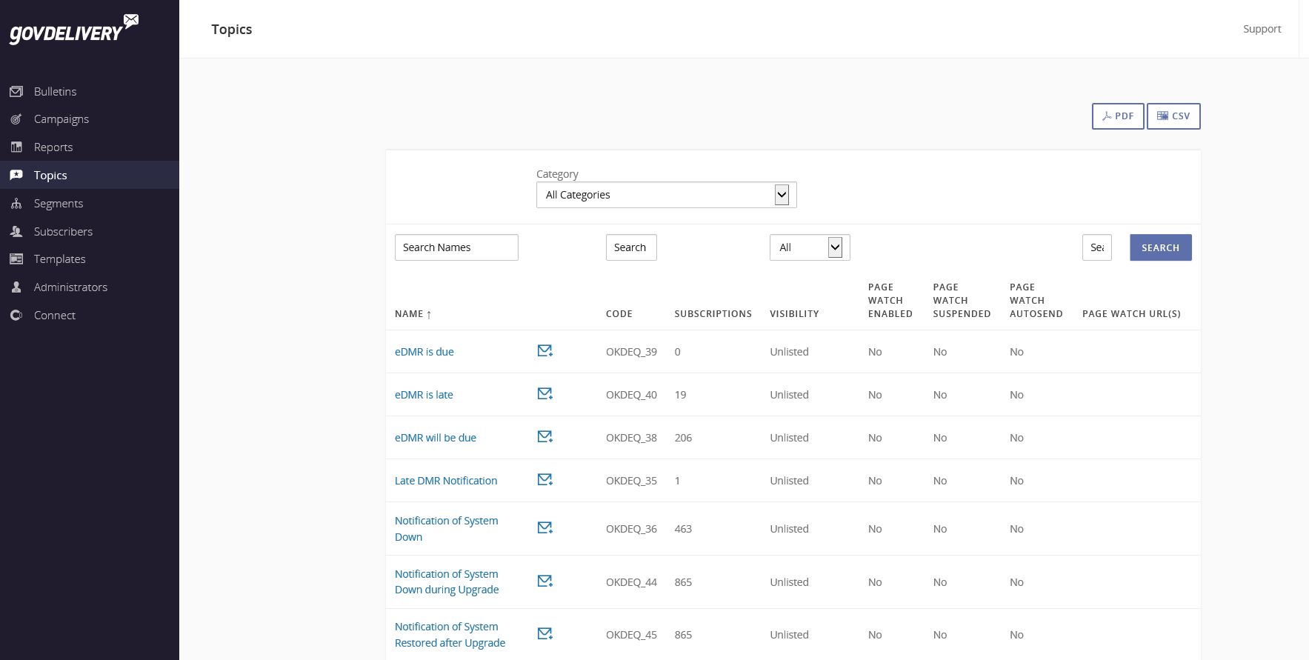

Slide 49
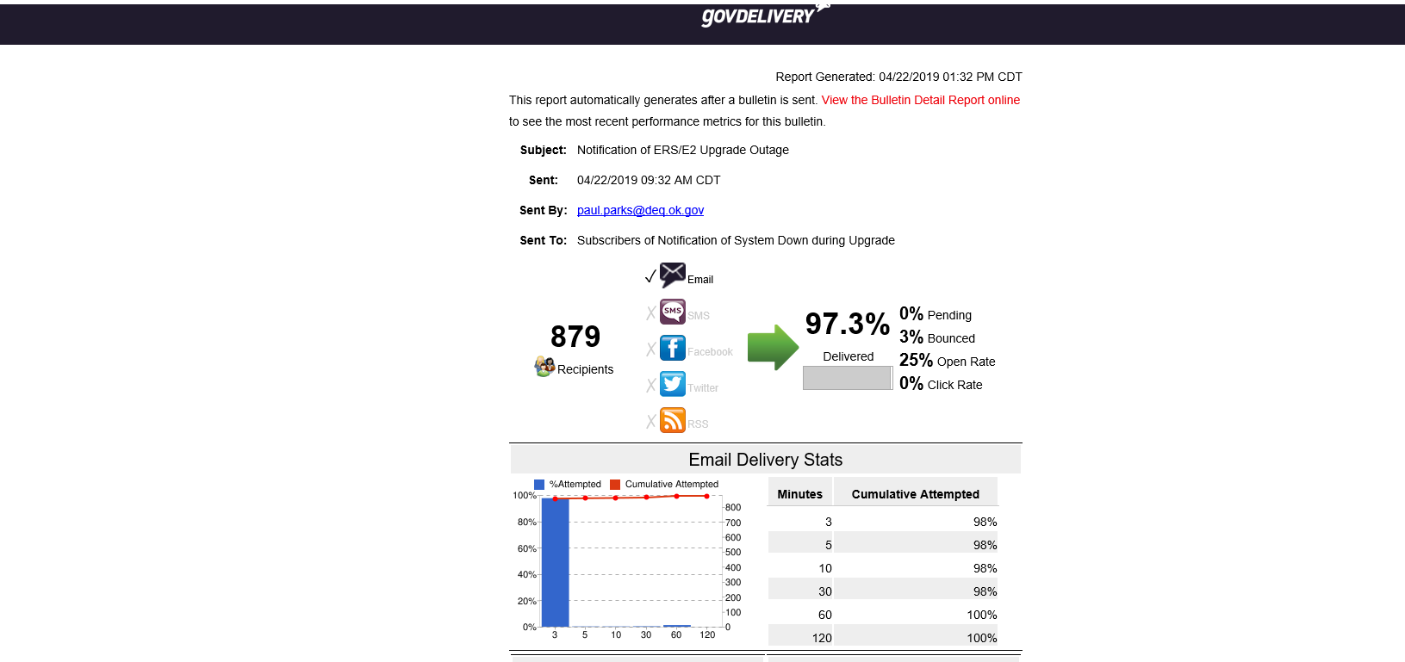

Slide 50
Long-term Strategies to Address Federal Facility SNC
Continue data-sharing and dialoguing with Federal Agency HQs
Identify FFs in SNC for regions/states
Fund/conduct FF inspections or compliance assistance work
Improve FF data quality in conjunction with data sub-workgroup
Develop webinars/compliance alerts/content for FedCenter
Continue outreach – present at meetings with Federal Agencies

Slide 51
Contact Information
Wayne Morey
wayne.morey@deq.state.gov
405-702-8138
Charles Garcia
Charles.Garcia@deq.state.gov
405-702-8220

