Slide 1
E2 Revisions
How to revise an eDMR that has been rejected by a signatory or a member of DEQ.

Slide 2
E2: Revision Information
There are a few ways that an eDMR that has been submitted will then need to be revised and resubmitted
A Signatory submits a signed eDMR and an Enforcement Coordinator reviews the document and finds a problem with it. They will then reject it and all Signatories associated with that facility will get an email notifying them that they will need to revise the eDMR and it will include a comment on why they have rejected it.
A Signatory finds an error with it when they are in ERS and they revise it themselves.
NOTE: In either case, the revision process with be the same.

Slide 3
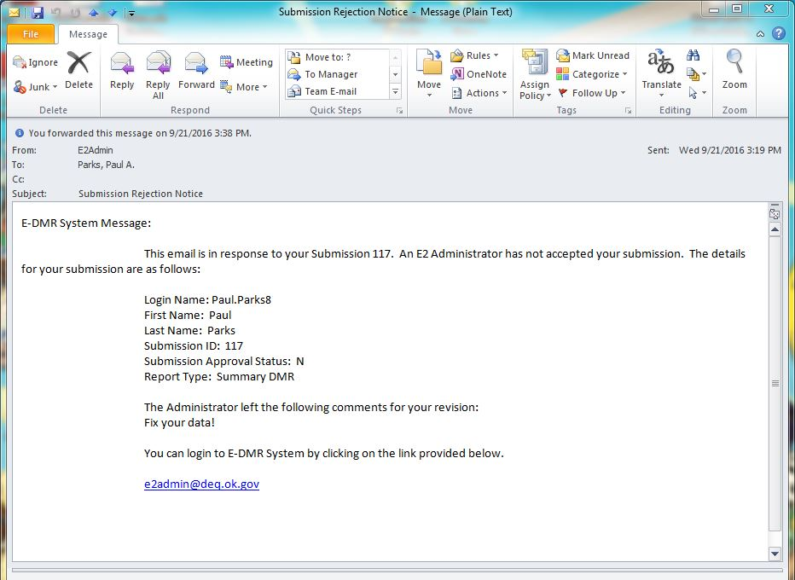
E2: Rejection Email from DEQ
This is the Submission ID found on the submission receipt for the eDMR that needs correction
General information about the rejected eDMR
Comments from DEQ as to why the eDMR was rejected.
https://applications/deq.ok.gov/e2

Slide 4
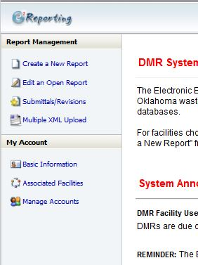
E2: Revision – Starting from after E2 login
To begin the revision process, click here

Slide 5
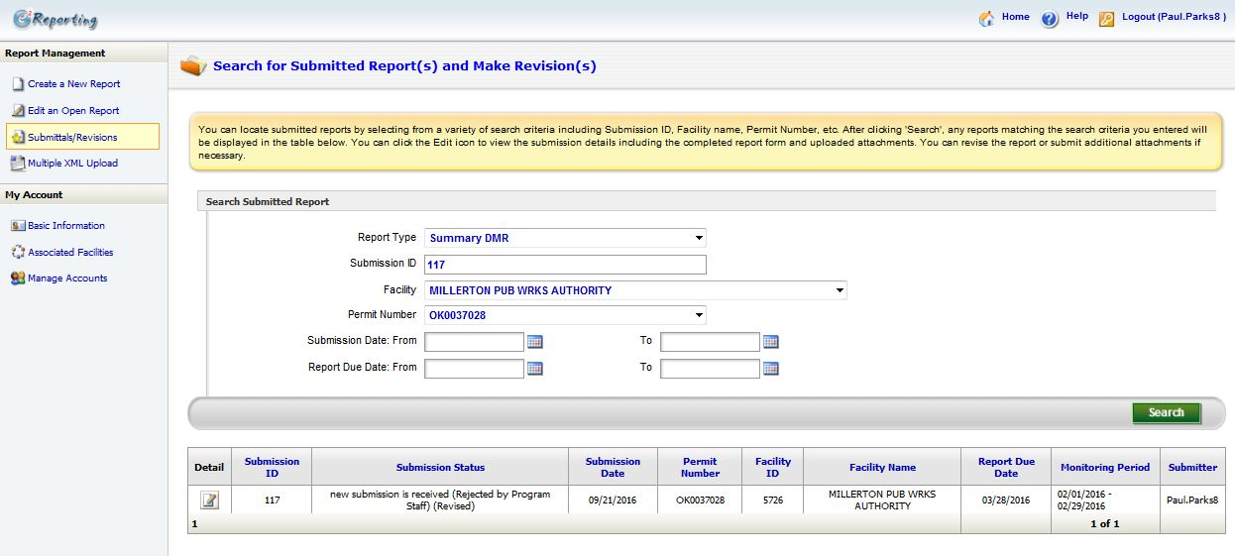
E2: Revision – Search
This number comes from the Rejection email you get from DEQ. It can also be given by they Signatory.
Enter Facility Information
Delete anything that may be in these fields
Click “Search”
List of Submitted eDMRs matching the criteria given
Click here to open the eDMR

Slide 6
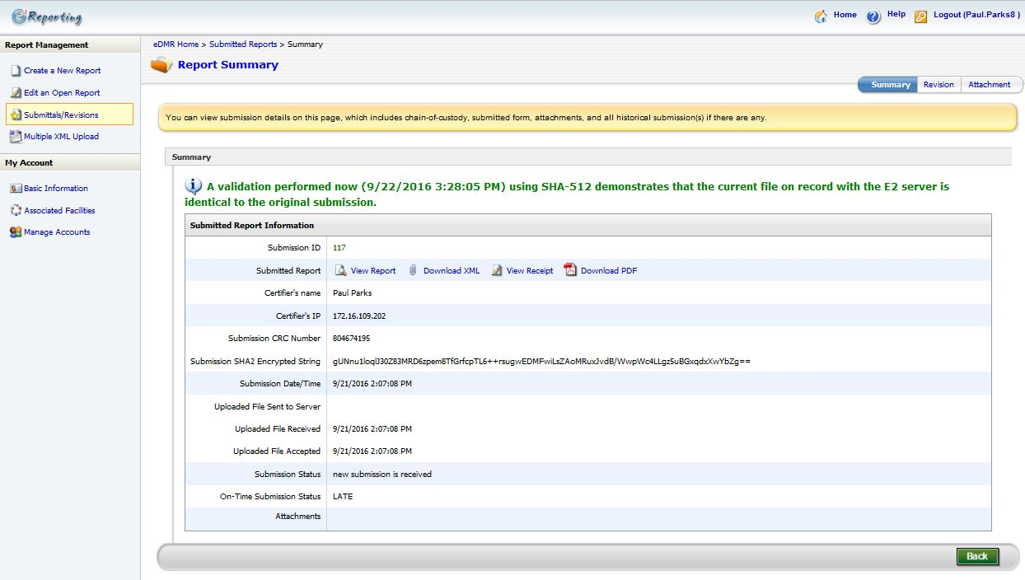
E2: Revision
Click on the “Revision” tab to revise the selected eDMR

Slide 7
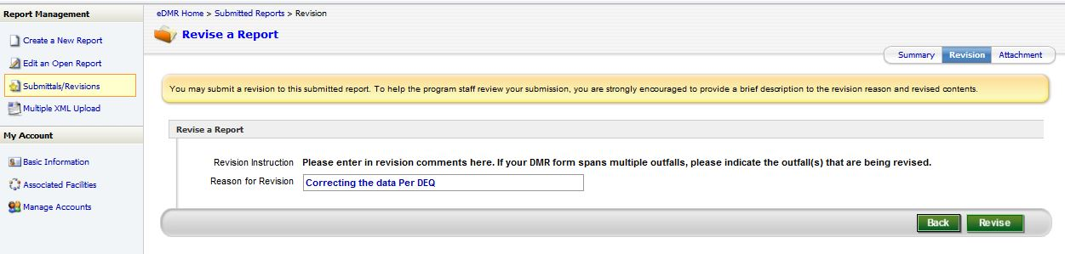
E2: Revision – Revision Reason
Enter the reason for the Revision
Click “Revise” to continue

Slide 8
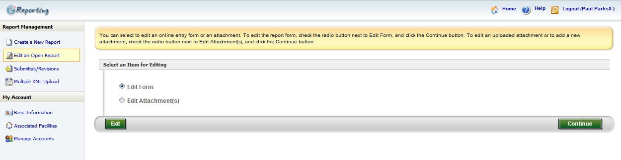
E2: Revision
Choose Edit Form
Click Continue

Slide 9
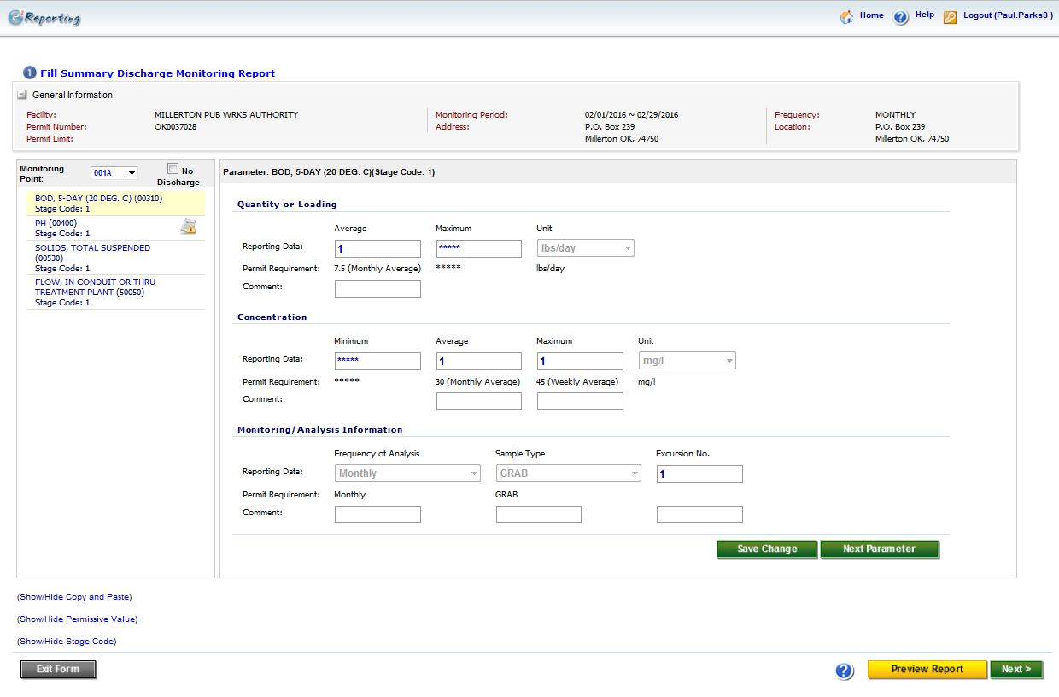
E2: Revision – Correcting Values/Data
Click on the parameter that needs revision
Change the values that need to be revised
If everything looks correct, click Next
Click here to preview what the eDMR will look like

Slide 10
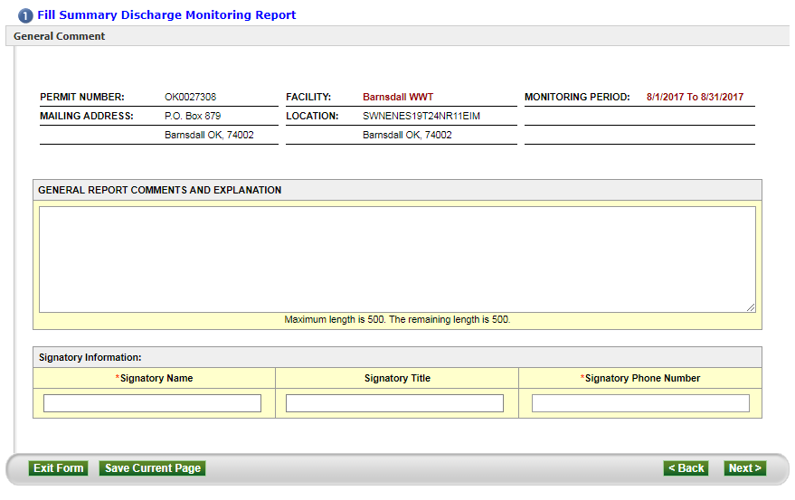
E2: Revision
You must enter a comment denoting that this is a Revised DMR
Enter the Signatory’s Name
Enter the Signatory’s phone number
Click Next

Slide 11
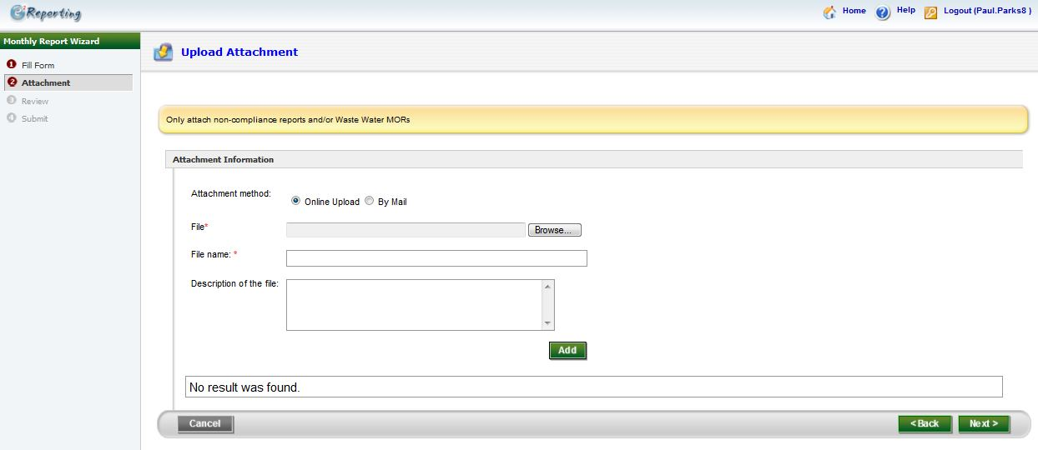
E2: Revision
This page is optional. If you have a “Non-Compliance Report” and/or “Waste Water MORs” you can use this page to attach it to your eDMR submission
Click Next

Slide 12
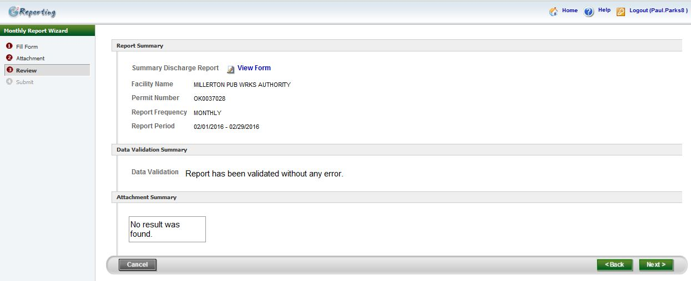
E2: Revision
Click here to view a copy of the eDMR you will be submitting
Click Next

Slide 13
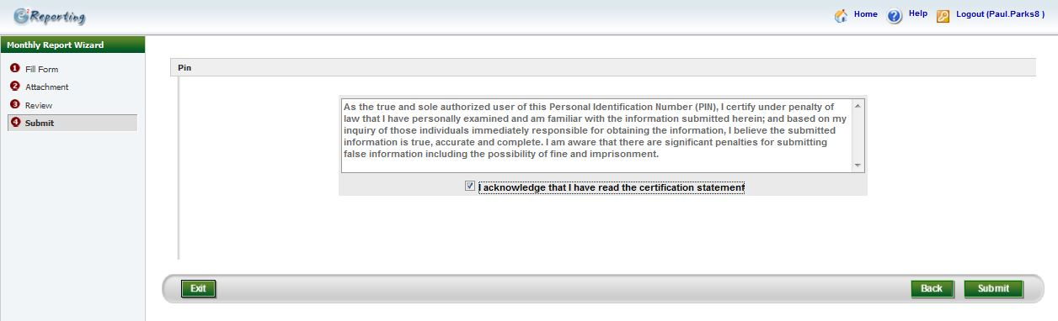
E2: Revision - Submit
Read the Agreement
Click Submit
Check the “I acknowledge that I have read the certification statement”

Slide 14
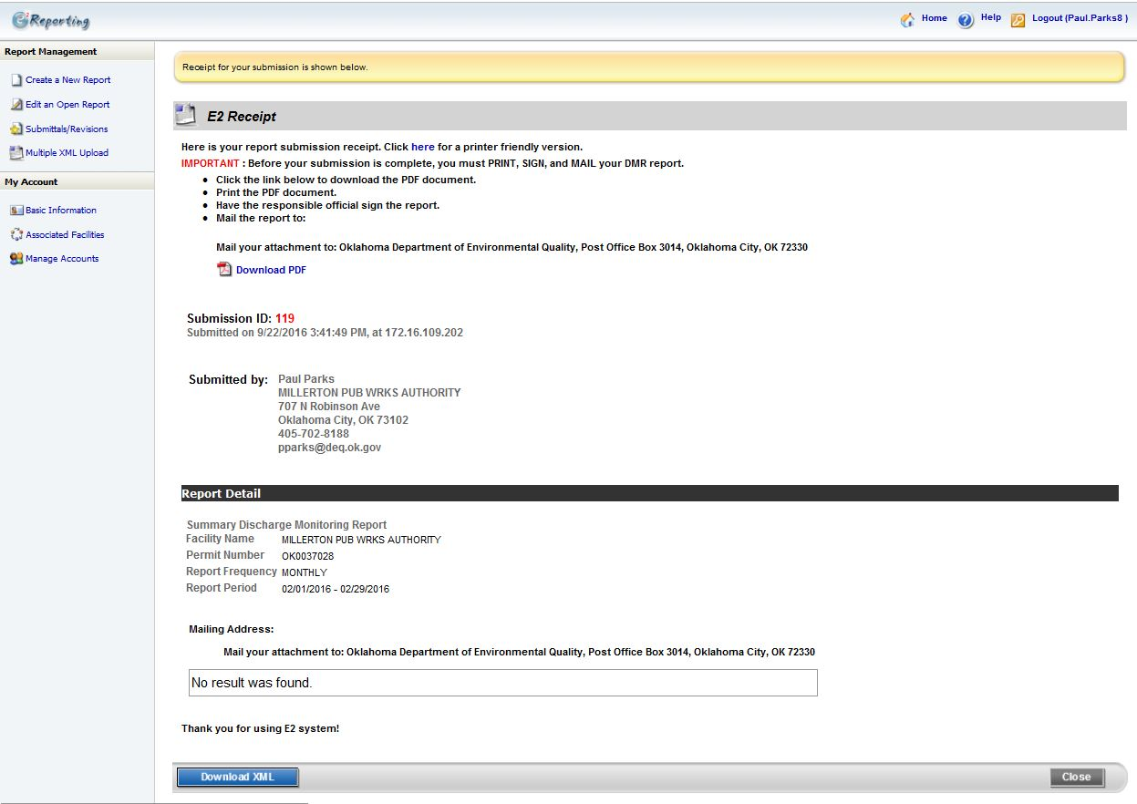
E2: Revision – Submission Receipt
It will treat any submittal as a new submittal. That is why the ID will change. Keep this in mind.

Slide 15
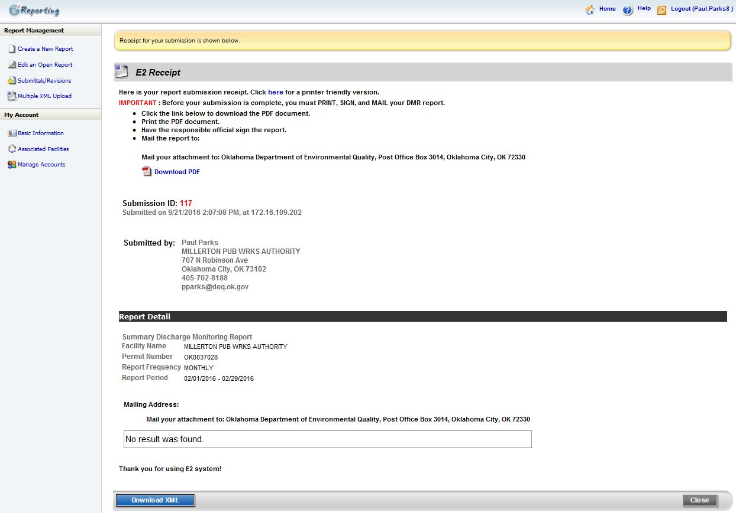
E2: Submission Receipt
After submitting the eDMR in E2, you will get an E2 Receipt. You will then click the home button above.

Slide 16
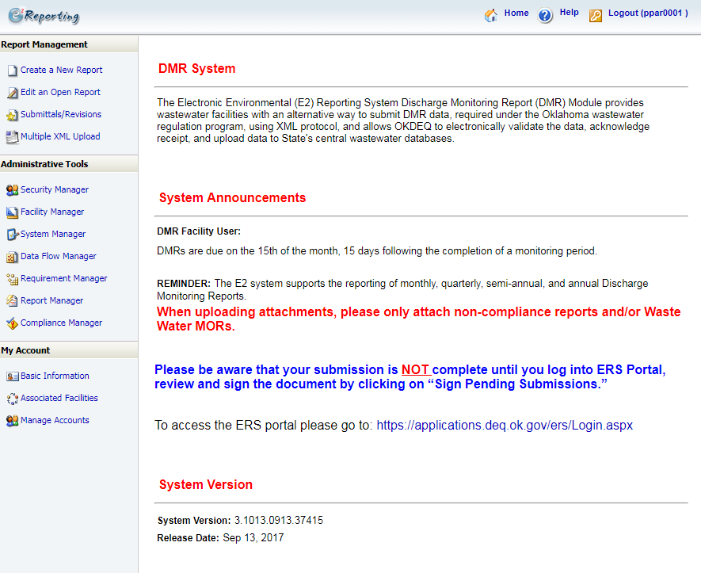

E2: Home Page
Click here to go to ERS to sign your submission.

Slide 17
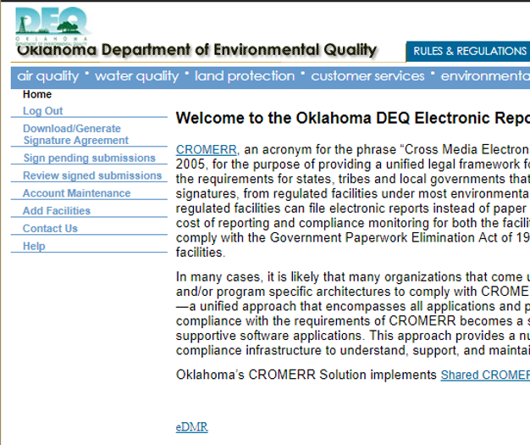
ERS: Signatory Sign and Submit eDMR
Submitting a Preparer Created eDMR
From the ERS Home Page, after you log in
Click here to view all e-DMR submissions.

Slide 18
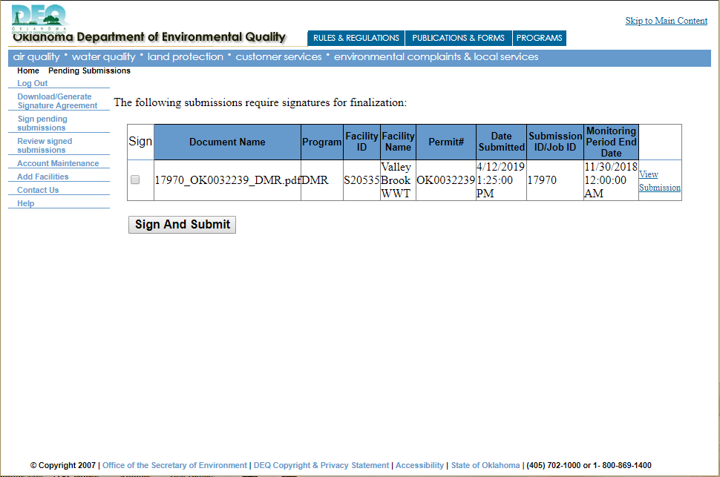
ERS: Signatory Sign and Submit eDMR
Submitting a Preparer Created eDMR
Check Mark this Box
Click on “View Submission” to view your eDMR.
Click “Sign and Submit”

Slide 19
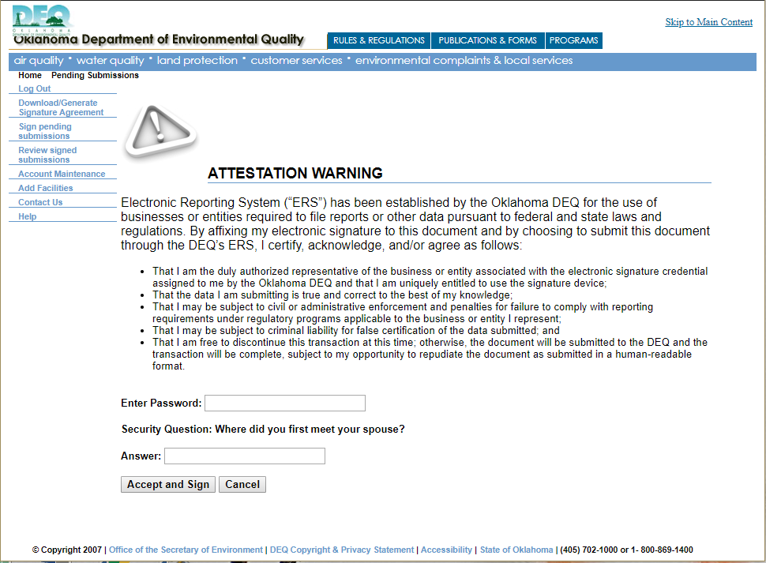
ERS: Signatory Sign and Submit eDMR (Sign and Submit)
Submitting a Preparer Created eDMR
Read the Statement
Enter your Account Password
Click “Accept and Sign”
Answer the Security Question

Slide 20
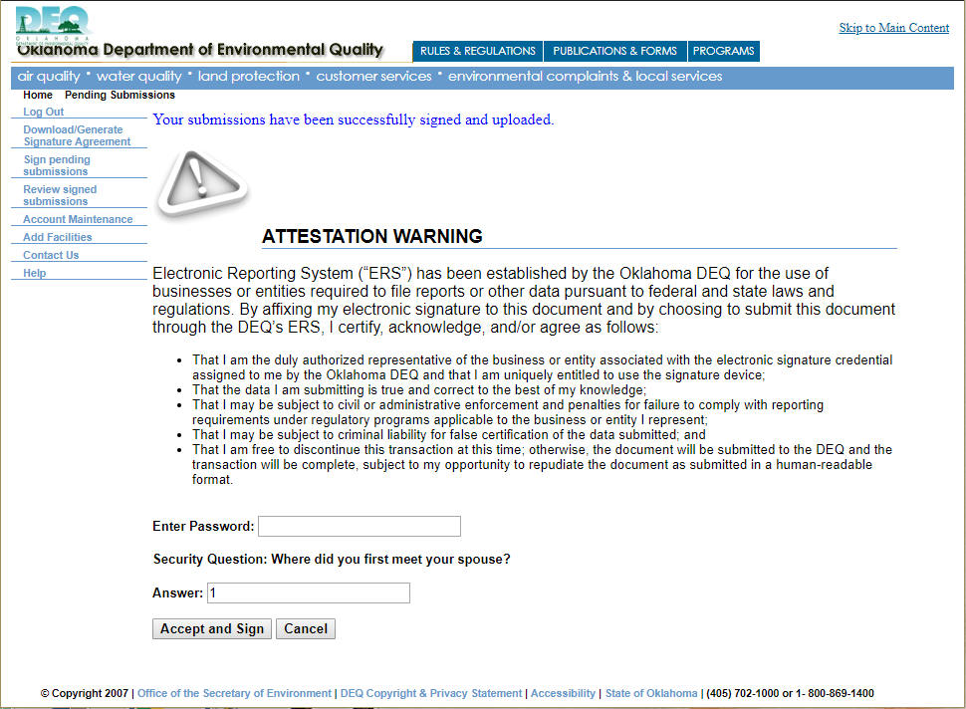
ERS: Signatory Sign and Submit eDMR (Sign and Submit)
Submitting a Preparer Created eDMR
Once the submission has been submitted, you will receive the above message, and an email saying that it was received. You are done with the eDMR submission process.

