Slide 1
LEPC Tier II Agreements & Payment Applications

Slide 2
Why does DEQ utilize LEPC Tier II Agreements & Payment Applications ?
DEQ serves as a central repository for all Tier II data this is not the case in other states.
DEQ collects all the Tier II data for the state and distributes that data back down to each of the 77 County LEPC’s.
The agreement is USED AS AN Instrument to ensure that the data is getting to those that need it in each county.
The 1,000.00$ payment is an appreciation for the LEPC after distribution of the data locally

Slide 3
LEPC Agreements
Agreement Between DEQ & the 77 County Local Emergency Planning Committees
Fiscal year agreement beginning July 1 & ending on June 30 each year.
DEQ shall provide TIER II information received from the regulated community in the state of Oklahoma to every county LEPC on or before April 1.

Slide 4
LEPC Agreement Duties & Obligations
Provide
Provide Tier II information received from DEQ to all paid and volunteer fire departments within the boundary of the LEPC, either electronically or paper copy.
Act
Act as a central repository for Tier II information allowing access and informing all paid and volunteer fire departments within the LEPC’s jurisdiction about procedures for obtaining information.
Maintain
Maintain a list of fire departments & points of contact receiving the most current Tier II information.
Submit
Submit to DEQ annually the methodology by which the Tier II reports were distributed or made available to fire departments in its jurisdiction.
Submit
Submit to DEQ annually a list of current LEPC officers.
Submit
If seeking payment, submit to DEQ annually a payment application for Tier II distribution before June 30.

Slide 5
LEPC PAYMENT APPLICATIONS
LEPC’s that have an agreement on file for the current fiscal year will receive a payment application by email on or before April 1st.
Payment Applications must be turned in no later than June 30 of the current fiscal year to receive funding.

Slide 6
Payment Application Form Changes
This year DEQ accounts payable has included payments by credit card as an additional way to receive LEPC payments.
Payments by check will still be available.

Slide 7
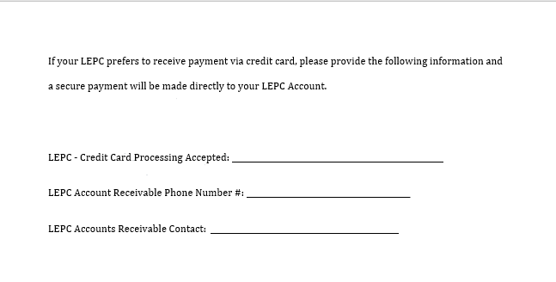
LEPC Credit Card Payments

Slide 8
LEPC Payments.
1000.00$ for distributing Tier II data
Must have an Agreement and PAY APP on file to receive the payment
Money can be used for the following:
Food & Drinks for LEPC Meetings
Any equipment needed for LEPC activities. i.e Laptops or Tablets.
Anything the LEPC feels can related to emergency planning and preparedness and the County/LEPC EOP

Slide 9
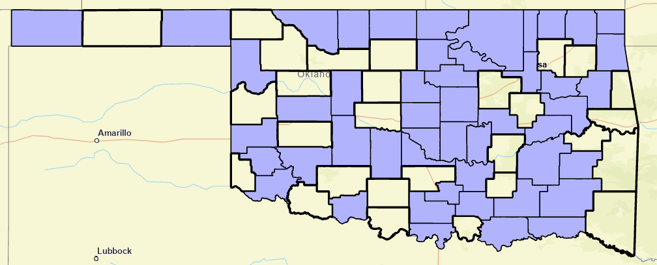
LEPC’S with agreement on file for FY23-24

Slide 10
Questions about LEPC Tier II agreements or Pay Apps?
Email – Tommy.Holbrook@deq.ok.gov
Call 405-702-5156

