Slide 1
Chemical Reporting & Preparedness at DEQ

Slide 2
The Chemical Reporting and Preparedness Section covers and regulates the rules of EPCRA (Emergency Planning and Community Right-to-Know Act)

Slide 3
What led to EPCRA
December 3, 1984, Bhopal India
Union Carbide Plant accidental release of deadly Methyl Isocyanate gas used in pesticide manufacturing
Kanawha Valley of West Virginia
On August 11, 1985, 500 gallons of aldicarb oxime and highly toxic MIC leaked from the Institute plant. Although no one was killed, 134 people living around the plant were treated at local hospitals.
United States Congress passed the Emergency Planning and Community Right-to-Know Act (EPCRA) in 1986.

Slide 4
What does EPCRA cover at DEQ?
Tier II Reporting
Spill Reporting
LEPCs (Local Emergency Planning Committees)
State Emergency Response Commission
Oklahoma Hazardous Materials Emergency Response Commission

Slide 5
Tier II Reporting
Database of facilities in Oklahoma that store over a reporting threshold of hazardous materials in the state.
Over 50,000 reports annually
Covers facilities from Tank Batteries to Chemical Facilities to Water Treatment Plants
Reports are submitted between January 1 and March 1 of every year.

Slide 6
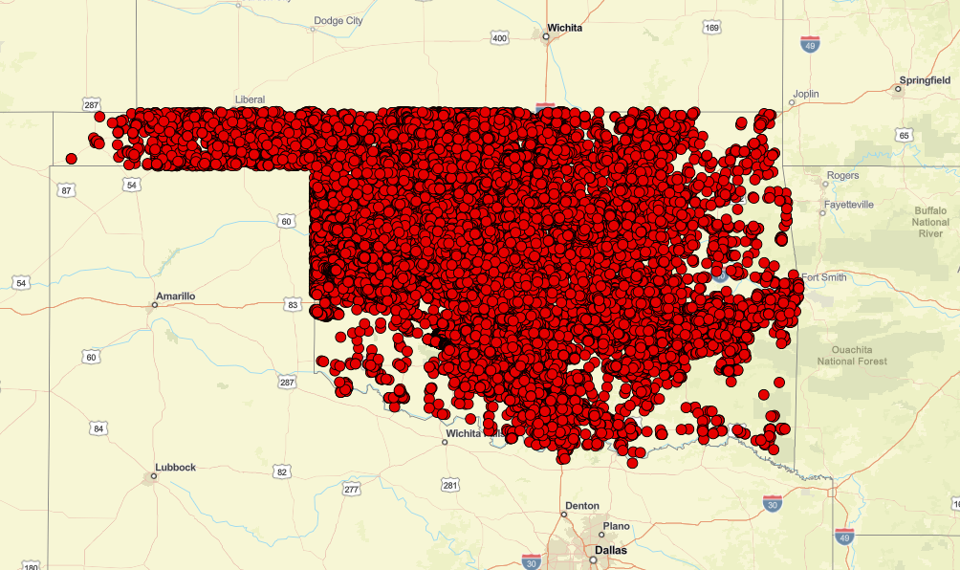
Geospatial representation of the 2023 Tier II Database.

Slide 7
Tier II Reporting
Reports are filed to the DEQ
DEQ then disperses Tier II Data to the County LEPC. County then disperses the data to the First Responder in that area
Public may request a copy of a Tier II Report by submitting a request for data to the DEQ

Slide 8
Spill Reporting
Facilities must immediately report the accidental release of any substance subject to regulation from the Consolidated List of Lists that is equal to or exceeding the corresponding reportable quantity (RQ)
Facilities must report all spills to
The National Response Center (NRC)
Local First Responders/LEPC (Typically local 911)
State Partners (For the state of Oklahoma this is the 24 Hour ECLS Hotline)

Slide 9
Local Emergency Planning Committees
DEQ oversees the Local Emergency Planning Committees in Oklahoma on behalf of the OHMERC
77 LEPCs were designated upon EPCRA’s implementation. Every county has an LEPC
76 active right now

Slide 10
Who is in the LEPC
Each local emergency planning committee shall include, at a minimum, representation from each of the following groups or organizations:
1. Elected state and local officials;
2. Law enforcement;
3. Civil defense;
4. Fire fighting;
5. First aid;
6. Health;

Slide 11
7. Environmental;
8. Hospital;
9. Transportation personnel;
10. Broadcast and print media;
11. Community groups;
and 12. Owners and operators of facilities which manufacture, store, or use in any manner those substances specified as extremely hazardous by the administrator of the federal Environmental Protection Agency.

Slide 12
Requirements of the LEPC
Develop an emergency response plan
Evaluate the need for resources necessary to develop, implement, and exercise the emergency plan, and shall make recommendations with respect to additional resources that may be required and the means for providing such additional resources
Review the plan at least annually

Slide 13
Provide information about chemicals in the community to citizens.
Take such other action as may be required by the Oklahoma Hazardous Materials Emergency Response Commission or as otherwise deemed necessary to implement the provisions of this act or the federal Superfund Amendments and Reauthorization Act
Comply with the Oklahoma Open Meeting Law

Slide 14
Oklahoma Open Meeting Law
Every regular, special, emergency, or reconvened meeting of a public body shall be open
Required Pre-Meeting Actions
Provide Notice
Annually by December 15 for the next calendar year ▫ Include date, time, and place of meetings
Regular meetings can be changed with 10 days notice
To whom?
County public bodies: County Clerk of the county where the body is principally located

Slide 15
(Cont.)
Post Agenda
Display agenda 24 hours prior to meeting
Where?
1. Post notice and agenda at principal office (or location of meeting if no office exists)
OR
2. Post on public body’s website ▫ Must also maintain an email distribution system and send notice to this group no less than 24 hours in advance, ▫ AND, post notice and agenda at the principal office (or location of meeting) during normal business hours at least 24 hours in advance

Slide 16
CAMEO and MARPLOT
Free Emergency Management Software used by CR&P Staff
As well as Emergency Managers and Tier II Facilities
Mapping component in MARPLOT allow for the overlaying of Tier II sites along with schools, hospitals, and other local points of interest
Free Training and help available by CR&P Staff

Slide 17
Contacts at DEQ
Matt Wormus
Tommy Holbrook

