Slide 1
Tips for Keeping an LEPC Active
Region 6 LEPC Workshops

Slide 2
So what makes for a successful LEPC ??

Slide 3
Factors for Success
From Previous Surveys:
Dedicated membership
Regular and meaningful meetings
Leadership which believes in LEPC mission
Support from local elected officials

Slide 4
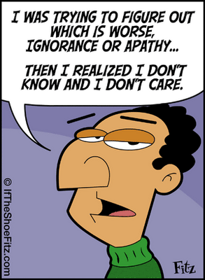
Unsuccessful Factors
Previous Surveys
Lack of serious chemical risks in the community Lack of interest by citizens and stakeholders Lack of even basic funding

Slide 5
Few simple tips for energizing dormant LEPC, or keeping one active

Slide 6
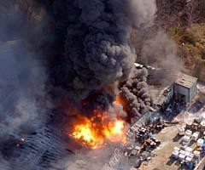
Sadly, many believe the best way to energize an LEPC is to have a major incident.
Not encouraging
that…

Slide 7
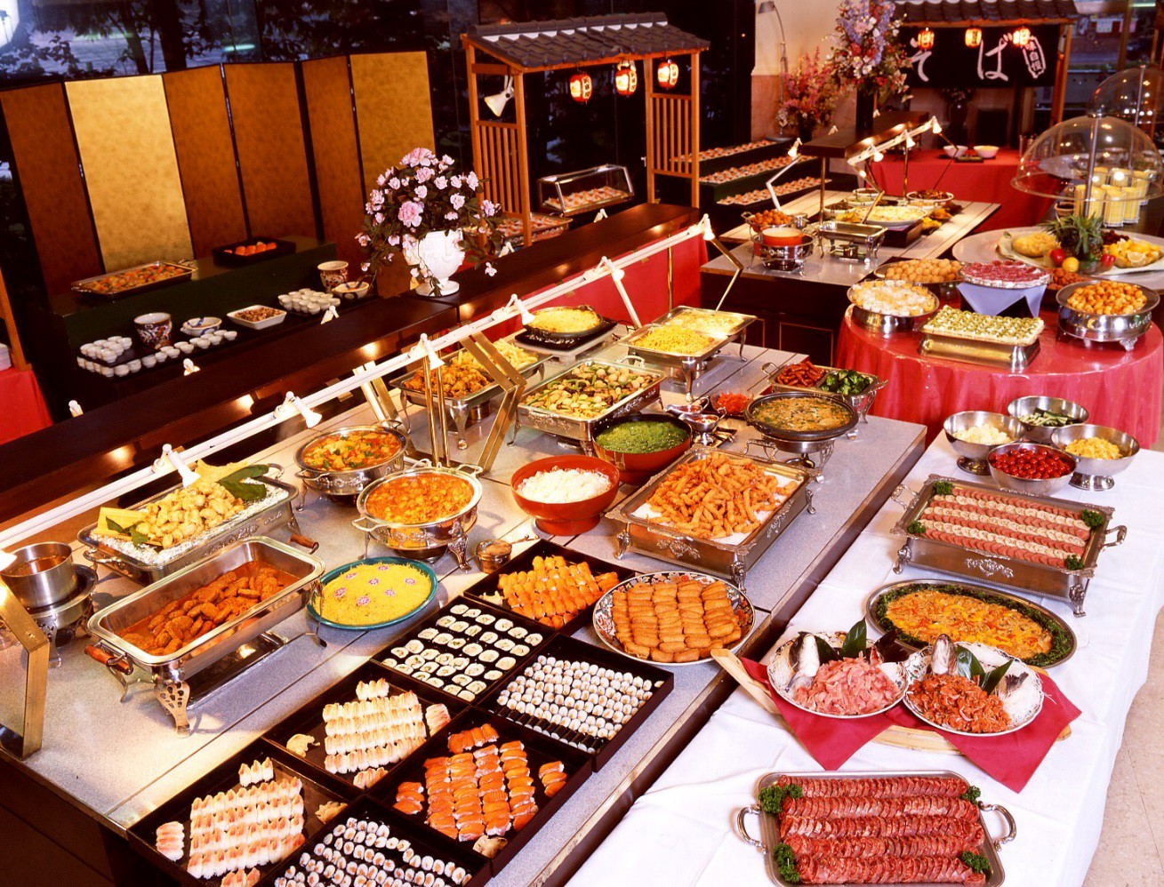
Feed ‘Em !

Slide 8
Use meetings as a training forum
Stay up to date on rule changes
Roles and responsibilities
New technologies for response equipment, resources

Slide 9
LEPC leaders must believe in the purpose
Must be able to inspire others to also believe in the purpose
Keep purpose, goals, and approach relevant and meaningful.
Build commitment and confidence
Diversify mix and level of skills
Manage relationships with outsiders, including removing obstacles
Create opportunities for others
Do real work

Slide 10
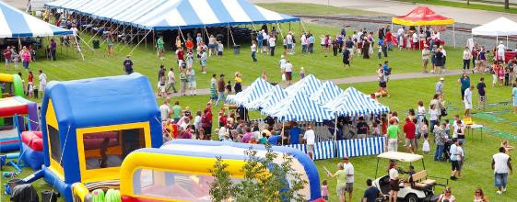
Consider social activities to build relationships between LEPC members
Ensure all LEPC members are involved in planning and execution of exercises
Encourage volunteers to work together at community events, such as county fairs, etc.

Slide 11
“Tell me and I'll forget; show me and I may remember; involve me and I'll understand.”
Don’t just use your own LEPC members to accomplish all the tasks you wanted completed… find others in the community who want to help (students, volunteers – Citizen Corp, senior citizens, teachers, etc.)

Slide 12
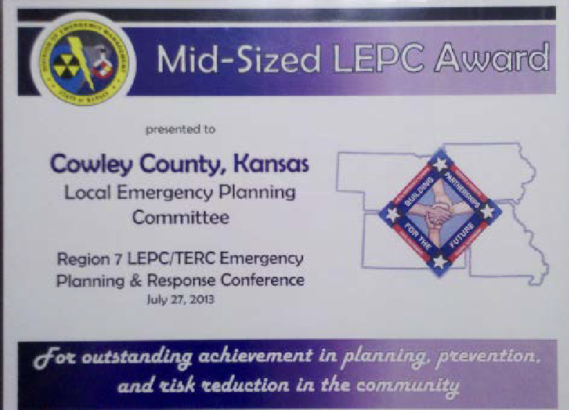
Recognize achievement
Causes people to strive for more achievements
Nominate members for awards within their own organization or societies
Provides visibility to facilities within their own corporate structure

Slide 13
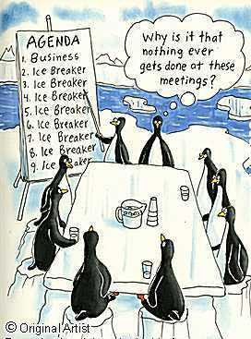
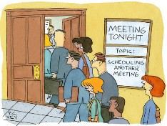
Hold Productive Meetings:
Annual Meeting to review plan
Meeting at Tier II deadline
Regular but flexible meetings
Guest Speakers

Slide 14
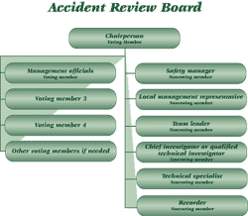
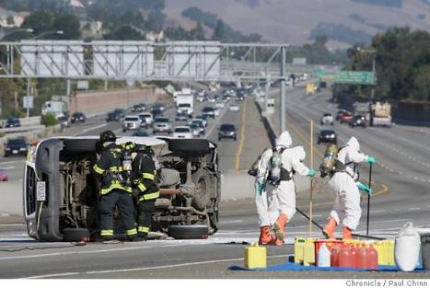
Conduct emergency response review after incident

Slide 15
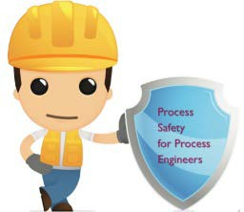
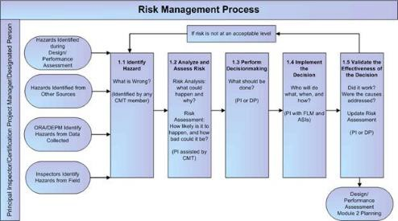
Conduct facility process reviews

Slide 16
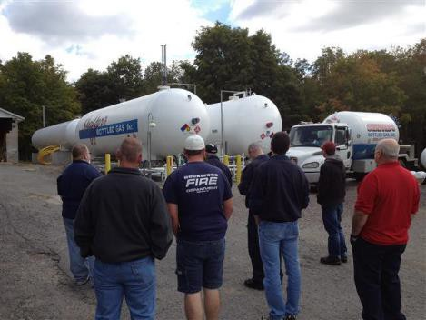
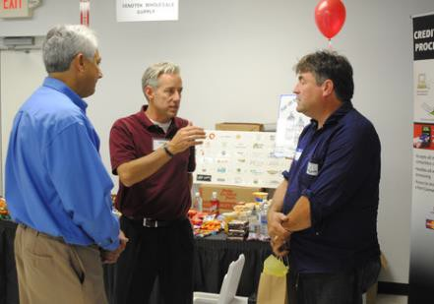
Hold meetings at facilities within the community

Slide 17
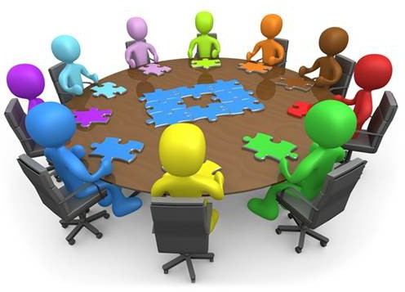
Involve all members in exercises, especially table-top exercises

Slide 18
Some simple things to remember for your LEPC:
More assistance leads to more compliance
LEPCs don’t like surprises
Prevention can be
born out of preparedness
A well-rounded LEPC equals compromise and good community relations

Slide 19
Some simple things to remember for your LEPC:
Help can come from unexpected places
It’s all in the presentation!!
The commitment is there, it’s the time that’s needed
Information should
not be a paper

Slide 20
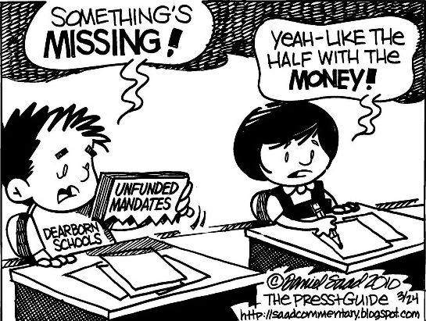
Some simple things to remember for your LEPC:
Get the most out of the data collected
All companies must
be aware of accidents waiting to
happen
Yes, it is an unfunded mandate, but…
Integrated planning at all
levels can overcome obstacles

Slide 21
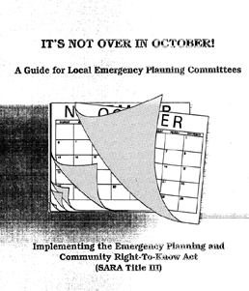
Some simple things to remember for your LEPC:
Constantly go back
to the basics
Facilities are partners, not targets
It’s Not Over when the Plan is Written
Integrate Tier 2 info with other data

Slide 22
Some simple things to remember for your LEPC:
LEPC support all- hazard planning
Industry and emergency responders must be informed and involved
Money Isn’t
Everything
Develop partnership with
neighbors
5/22/2018

Slide 23
Some simple things to remember for your LEPC:
Outreach is a continuous process
Membership Should be Inclusive
Success involves commitment, patience, and persistence
LEPC role can go
beyond planning

Slide 24
Some simple things to remember for your LEPC:
Remove Hindrances
Keep linked with other programs
•
Stay Positive !
5/22/2018

