Slide 1
EPA’s New PFAS Drinking Water Regulation
Path to Compliance

Slide 2
Outline
1. What is PFAS?
2. What’s the Big Fuss?
3. Final PFAS Rule
4. Monitoring Requirements
5. Treatment Options
6. Funding Sources

Slide 3
What is PFAS?
Per- and Poly-fluoroalkyl Substances
Notes:
To start, we will discuss what PFAS, or Per- and Polyfluoroalkyl Substances, is and briefly go over its history

Slide 4
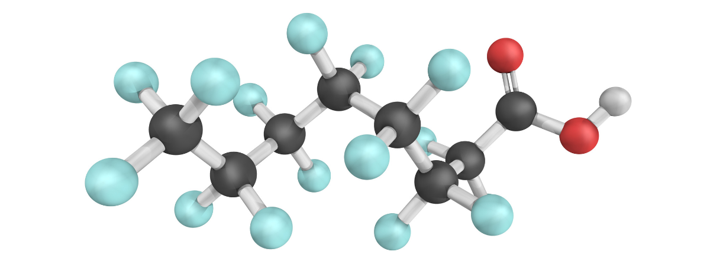
Class of synthetic chemical compounds
Nearly 15,000 individual chemicals
Organic compounds with incredibly stable bond
Does not allow chemical to break down in “normal” amount of time
Ubiquitous in environment now.
99% of all humans have measurable levels of PFAS in their bloodstream
Short Chain vs Long Chain
Long chain PFAS have high bioaccumulation potential
Short chain PFAS can be more difficult to remove
Notes:
PFAS is not a single compound, but is a class of chemicals that have similar makeup and properties
Large number of individual chemicals classified as PFAS.
Stable bond that takes thousands of years to break down
Leads to buildup in environment and in people
PFAS is everywhere now, despite being first developed in 20th century
Two different main types of PFAS
Short chain and long chain
Each has own risk factors
Long chain PFAS have high bioaccumulation potential
Short chain PFAS are harder to remove
Long chain break down into short chain

Slide 5
Where is it from?
Manufacturing Processes
Fire-fighting foam
Many products that are:
Stain resistant
Waterproof (Scotchgarde)
Nonstick (Teflon)
Food packaging
Notes:
Where does PFAS come from?
Manufacturing processes in idustries such as:
aerospace
automotive
construction
electronics
PFAS is in many items we use every day.
Teflon, Scotchgarde, AFFF
Carpets

Slide 6
PFAS Production
Occupational Exposure
Significant exposure potential
Less significant exposure potential
PFAS Use in Manufacturing
Environmental Occurrence
Ecological Exposure
PFAS in Industrial Products
Consumer or Residential Exposure
PFAS in Consumer Products
Notes:
This diagram is an overview of PFAS exposure from different methods and products.
There are 4 routes of exposure
Occupational –Workplace (manufacturing/industry)
Environmental – Accumulation
Ecological – Food chain/bioaccumulation
Consumer/Residential – Products
Different people are more likely to come in contact with PFAS in different ways
Part of job
Consumer products
Contaminated food/water
The focus of the new rule is on environmental and ecological exposure

Slide 7
History of PFAS
Movie: Dark Waters
Tells the story of Dupont lawsuit and the history of PFAS
Late 1930s
1950s
1970s
PFAS chemistry discovered
PFAS starts being used in manufacturing and consumer products
First occupational health studies on PFAS in exposed workers
Outline health impacts and blood levels
1990s
PFAS found in blood samples from general population
Early 2000s
PFAS documented in environmental samples
2016
Lifetime drinking water health advisory issued by EPA for PFOA and PFOS
2024
PFAS NPDWR released by EPA
Notes:
PFAS chemistry discovered in late 1930s and quickly spread to become ubiquitous
Health studies on PFAS were first published in 1970s, and by 1990s, general population blood samples had detectable PFAS
This has not been very long, but because of its variety of uses, has spread wide to now show up everywhere

Slide 8
What’s the big fuss?
Chemicals that last “forever” with long-term health effects.

Slide 9
Forever Chemicals
Specifically designed to not break down
Carbon-fluorine bond is one of the strongest chemical bonds
Present in nearly all Americans
Bioaccumulates – health effects worsen as it does
Notes:
PFAS are made up of chains of carbon atoms with numerous bonds to fluorine. Whether they are long chain or short-chain, the carbon fluorine bond is known to be one of the strongest in chemistry.
This causes problems, as they are very difficult to destroy once produced.
These substances are known to bioaccumulate, meaning that they can build up inside of our bodies, worsening health effects as they do so.
PFAS are believed to be present in the blood of most Americans according to the CDC
Health effects of PFAS exposure vary

Slide 10
Health Effects
Increases risk for cancer
Reproductive problems
High cholesterol
Can lower effectiveness of vaccines
Interferes with hormones
Notes:
PFAS exposure has been linked to many health effects.
Cancer: Increased chances of Kidney, prostate, and testicular cancer.
Reproductive/developmental: Decreased fertility and increased blood pressure in pregnant women. Low birth weight, developmental delays
Cholesterol: increased lipids in blood, including higher cholesterol,
Immune suppression/vaccines
Hormones: PFAS can disrupt endocrine functions, leading to hormone interference.

Slide 11
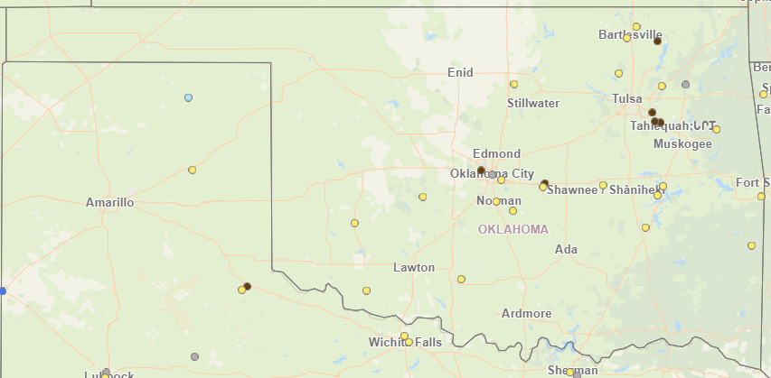
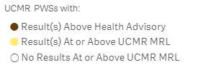
Occurrence in Oklahoma
Notes:
-Through some of the recent UCMR5 sampling we can see that there is PFAS present in Oklahoma. As more results come in, we will have a better understanding of the impact this rule will have on our state.
View this map by using EPA’s PFAS Analytic Tools on their website. You can use this tool to identify potential PFAS sources.

Slide 12
Final PFAS Rule
Who is required to comply with the rule and what are you required to do?
Notes:
-Now we will discuss the Final NPDWR on PFAS in drinking water and what that means for utilities.

Slide 13
Who does the PFAS rule apply to?
The PFAS rule requires all Community and Non-Transient Non-Community Public Water Systems (PWSs) to test for the presence of six different PFAS compounds in their drinking water.
This rule will impact over 1,100 PWSs across the state.
Notes:
Because the health effects from PFAS are largely chronic only C and NTNC PWSs will have to sample for PFAS.
-NC don’t have to sample
-Wholesale/source systems are the only one's sampling
-Consecutive systems that use purchased water are not required to sample.

Slide 14
Important Compliance Dates
Final Rule Published
Initial monitoring must be complete
Ongoing Compliance Monitoring
Maximum Contaminant Level Compliance starts
April 26, 2029
April 26, 2024
April 25, 2027
Start April 26, 2027
Notes:
- All initial monitoring must be complete by April of 2027 we will discuss the requirements for initial monitoring a little later. This monitoring is important because it determines the ongoing compliance monitoring frequency and your systems treatment needs
Compliance monitoring will start April 1, 2027 and Monitoring violations will be issued for failure to monitor.
MCL compliance will begin in 2029 giving PWSs some time to determine if treatment is necessary. Health based MCL violations start.

Slide 15
Monitoring Requirements
How Often and Where to sample
Notes:
Now that we know a little bit about the timeline for the PFAS rule let’s get into what it will require you to do.

Slide 16
Sample Locations
PFAS Sampling should take place at the entry point(s) to your distribution system. This is after any treatment but before the first customer.
Having a combined point of entry can reduce the number of samples you would take.
Notes:
-The point of entry is after treatment but before the first customer. For SW the Treatment plant is often the first customer.
-This will be where you are already taking your other EP samples like Nitrate-nitrite, VOCs and Inorganics
Combined POEs could reduce the sampling you are required to do when you have multiple sources of water.

Slide 17
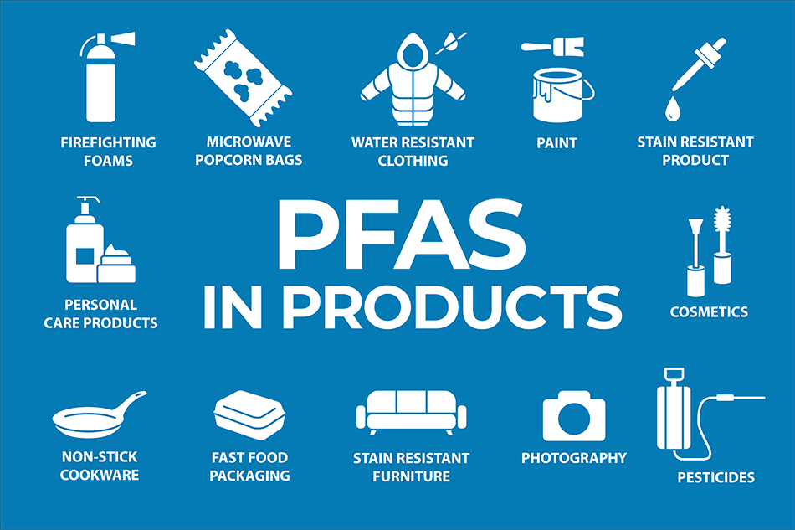
Sampling Best Practices
Use field blanks
Wash your hands
Complete bottle labels and Chain of custody (not sample time) before collection
Flush the line to mitigate chance of cross contamination
Fill sample bottles, but do not overfill
Once sample is collected, do not open bottle again
HDPE Equipment
Stainless steel equipment
Nitrile gloves
DEQ Drinking Water PFAS Sampling SOP
State Environmental Lab Services Sampling Instructions
Notes:
-Avoid wearing clothing with water or stain resistant coatings when sampling or handling samples. May of these contain fluorinated compounds. (Like GoreTex, Scotchgarde) Some good alternatives can be waxed canvas with non-fluorinated waterproofing compounds.
-These compounds really can be found everywhere but there is lots of information is available online for which products are free of any PFAS compounds.
-Make sure to follow any sampling instructions and guidance from your lab
-Deq has developed a PFAS sampling SOP that can help you avoid environmental contamination when sampling and the SELS has created sampling instructions specific to the state lab.

Slide 18
Initial Monitoring Frequency
Initial monitoring frequency will depend on source water type and population.
Initial monitoring must be complete by April of 2027.
System Type | Surface Water Systems | Groundwater Systems | Groundwater Systems
Population | All Pops | >10,000 | ≤10,000
Samples required | 4 quarterly samples 2-4 months apart | 4 quarterly samples 2-4 months apart | 2 samples within 12 months 5-7 months apart
Total samples for initial monitoring | 4 | 4 | 2
Notes:
All systems besides GW ≤ 10,000 must take four consecutive quarterly samples to complete initial monitoring. Any quarterly samples must be separated by at least 2 months. Ex: Taking each sample in the 2nd month of the qt all good. Take a sample in June at the end of 2q and then in July at the beginning of 3q and they will not count.
-The results from this initial monitoring will tell the systems who needs to consider treatment before the 2029 MCL compliance deadline.

Slide 19
Ongoing Compliance Monitoring
In 2027 ongoing compliance monitoring will begin and monitoring violations will be issued for those that fail to monitor.
The ongoing compliance monitoring frequency will be based on previous results.
The trigger level is ½ the MCL for each contaminant.
Result | Frequency of sampling
Result ≥MCL | Quarterly for RAA calculation
Results <MCL but ≥ trigger level | At least 4 quarterly samples then annual monitoring after determined reliably and consistently below the MCL
Result < trigger level | Every 3 years
Notes:
Based on initial monitoring results the frequency of your ongoing compliance monitoring can change.
The trigger level also applies to the unitless Hazard Index of 1
Like many of the contaminants you test for compliance determination for MCLs is done with a running annual average.
Double check >/</= for MCL

Slide 20
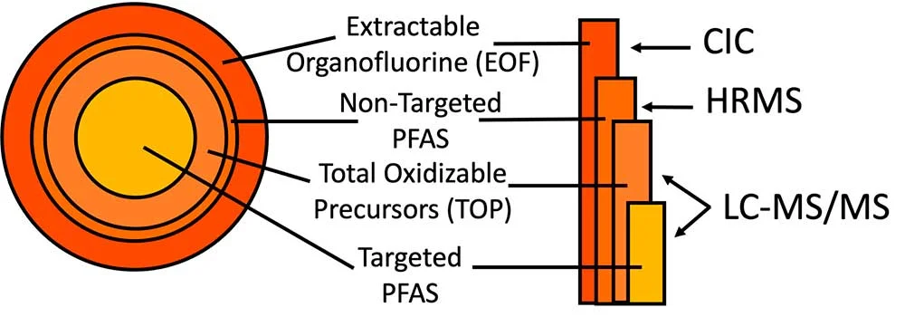
Certified Laboratories and Sampling Costs
State Environmental Lab Services
$250 per sample
Accurate Labs
$420 per sample
Field blanks = additional $420
Notes:
In the State of Oklahoma, there are two labs that are certified in PFAS Sampling: SELS and Accurate Labs
-Stress that the specificity of certain PFAS we are looking for is the reason for high analytical costs.
There may be other labs outside the state that can process the PFAS sample as well.
EPA methods
CIC = combustion ion chromatography
HRMS = high-resolution mass spectrometry
LC-MS/MS = liquid chromatography – triple quadrupole mass spectrometry

Slide 21
MCLs and MCLGs
Chemical | Maximum Contaminant Level Goal (MCLG) | Maximum Contaminant Level (MCL)
PFOA | 0 | 4.0 ppt
PFOS | 0 | 4.0 ppt
PFNA | 10 ppt | 10 ppt
PFHxS | 10 ppt | 10 ppt
HFPO-DA (GenX chemicals) | 10 ppt | 10 ppt
Mixture of two or more: PFNA, PFHxS, HFPO-DA, and PFBS | Hazard Index of 1 | Hazard Index of 1
Maximum Contaminant Level Goal (MCLG): The level of a contaminant in drinking water below which there is no known or expected risk to health. MCLGs allow for a margin of safety and are non-enforceable public health goals. Maximum Contaminant Level (MCL): The maximum level allowed of a contaminant in water which is delivered to any user of a public water system.
Notes:
In this rule EPA has established regulations for six (6) PFAS:
MCLs for 5 different PFAS compounds and
the hazard index which takes into account the potential additive effects of 4 PFAS compounds.
-You use the HI only when there is a mix of two or more PFAS compounds
- As mentioned previously MCL compliance is based on a RAA
-Significant figures matter. To be in violation of the MCL the RAA will need to round to the nearest sig fig. So an RAA of 12 ppt for PFNA would round down to 10 and you would not be in violation. However, a sample of 15ppt or greater would round up and be in violation
For the MCLs at 4.0 anything rounding to 4.1 would be in violation so 4.03 is less than MCL but 4.07 would round up.

Slide 22
The Hazard Index (HI)
The Hazard Index is a tool that EPA regularly uses to inform risks of chemical mixtures. The Hazard Index considers the different toxicities and additive dose of PFNA, GenX Chemicals, PFHxS, and PFBS.
Each of the contaminants in the hazard index has an established health-based value. To calculate the hazard index:
Step 1. Divide the measured concentration of Gen X by its health-based value of 10 ppt.
Step 2. Divide the measured concentration of PFBS by its health- based value of 2000 ppt.
Step 3. Divide the measured concentration of PFNA by its health-based value of 10 ppt.
Step 4. Divide the measured concentration of PFHxS by its health-based value of 10 ppt.
Step 5. Add the ratios from steps 1, 2, 3 and 4 together.
Contaminant | Health Based Value
GenX | 10ppt
PFBS | 2000ppt
PFNA | 10ppt
PFHxS | 10ppt
Notes:
The hazard index considers the additive health effects that some PFAS have.
Some PFAS can be found co-occurring with each other, and while they may be found in concentrations below the respective MCL's for individual compounds, the additive effect can mean this “PFAS soup” could still have negative health effects.
Systems will not have to calculate the HI we just want you to understand how it is calculated.

Slide 23
What is the Practical Quantification Level (PQL)
Contaminant | PQL (ppt)
PFOS | 4.0
PFOA | 4.0
PFHxS | 3.0
GenX Chemicals | 5.0
PFNA | 4.0
PFBS | 3.0
The PQL is a concentration of a contaminant that laboratories can measure with high certainty. If a laboratory provides a sample result less than the PQL, a zero will be used for that sample result to calculate the running annual average or hazard index used to determine compliance.
Notes:
-With PFAS compounds, the concentration at which they can be harmful to your health is so low, it is near the PQL. Some laboratories may report at levels below the PQL. For compliance determination any value reported bellow the PQL should be substituted with a zero.
Next we will go through some examples for calculating compliance with the hazard index.

Slide 24
Hazard Index Example
Contaminant | PQL
PFNA | 4.0
HI= (6/10)+(200/2000)+(0/10)+(4/10)
HI= 0.6+ 0.1+ 0+ 0.4
HI=1.1
HI>1 but with rounding it is equal to 1 for the compliance value.
Contaminant | Result (ppt)
GenX | 6
PFBS | 200
PFNA | 2
PFHxS | 4
HI= (11/10)+(20/2000)+(0/10)+(8/10)
HI= 1.1+ 0.01+ 0+ 0.8
HI=1.91
HI>1 and would round up to 2. This sample would be over the MCL for the Hazard Index.
Contaminant | Result (ppt)
GenX | 11
PFBS | 20
PFNA | 2
PFHxS | 8
Notes:
Here we will work through the hazard index step by step. The results from each sample are listed in the table.
Note that you can be in violation of both the hazard index and a single MCL.
-Note that in both these samples, though a result for PFNA is reported, because it is < the PQL, a Zero must be used when calculating MCL compliance.

Slide 25
Compliance Determination
Compliance with both the HI and single MCLs will be determined by a running annual average. Each sample result and HI calculation will be averaged over a rolling 12-month period.
This average will be used to determine compliance with the PFAS rule.
Compliance with The MCLs and Hazard index will be required in 2029
Notes:
In the instance you are sampling at a reduced frequency and a sample comes in that violates the MCL your schedule will be returned to standard monitoring for calculation of an RAA. Running Annual Average

Slide 26
Public Notification (PN) and the Consumer Confidence Report (CCR)
Any detects for PFAS will be reported on CCR
Any MCL violations will require additional health effect language on CCR.
Any violations will require PN.
Tier 3 PN will be required for monitoring violations.
Tier 2 PN will be required for MCL violations
One PN can be used to satisfy multiple MCL violations
Notes:
-Like other contaminants (regulated or part of the UCMR monitoring) results of sampling PFAS compounds must be reported on your consumer confidence report.
-The PN for PFAS compounds follow a framework like other contaminants. Tier 2 must be complete within 30 days and for tier 3 you have 1 year.
-Wholesale systems should inform their purchasers when there is a violation.

Slide 27
Treatment Options
Best available technologies for treatment
Notes:
The three best available treatment options: Adsorption via GAC, Anion Exchange, and Membrane Filtration

Slide 28
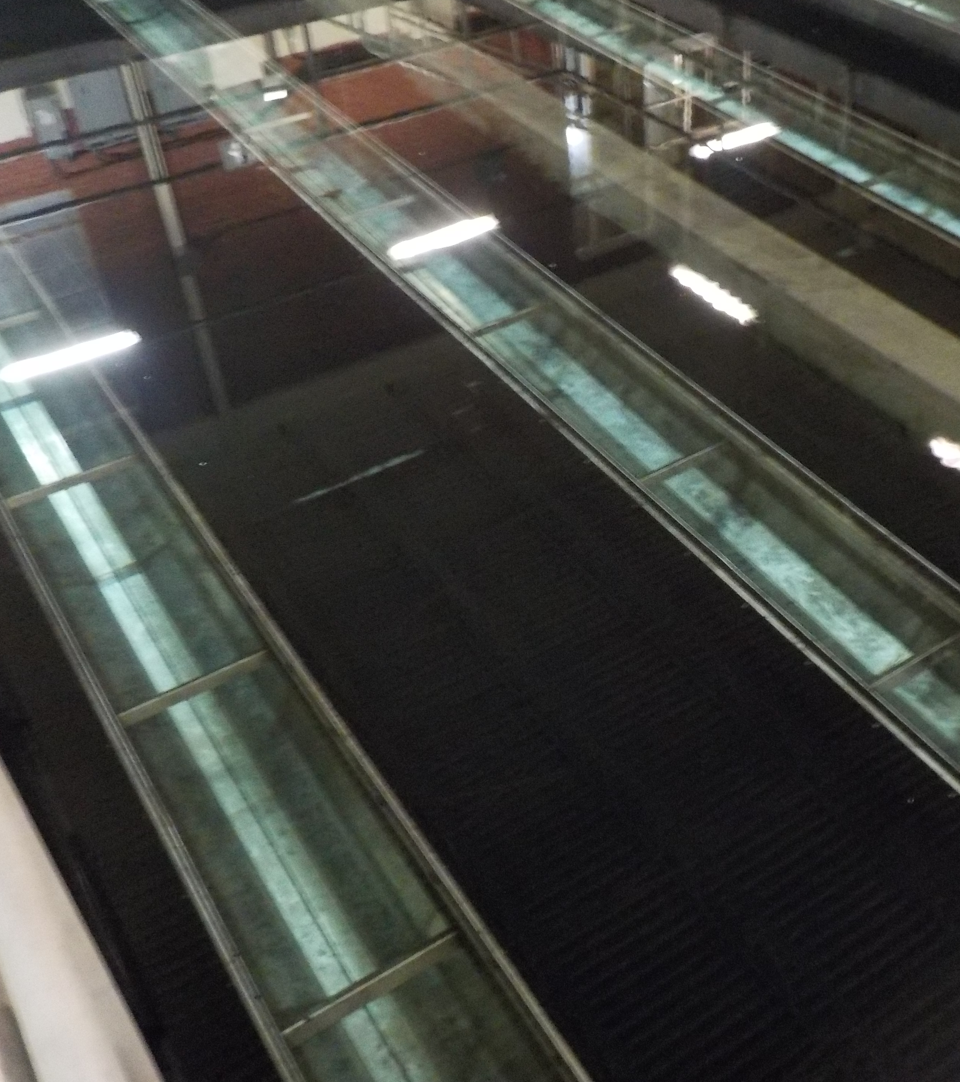
Granular Activated Carbon (GAC)
High carbon surface area traps and removes PFAS
Must replace media regularly to maintain treatment goals
Spent media will have high PFAS
Pilot study required before construction
Notes:
GAC can remove PFAS from the water via adsorption. Very costly, since the GAC must be replaced often.

Slide 29
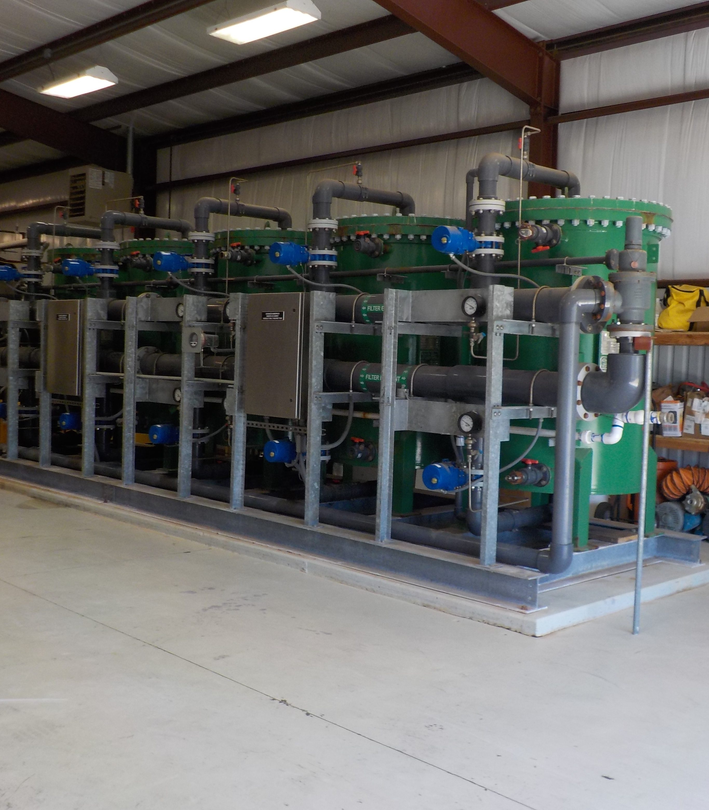
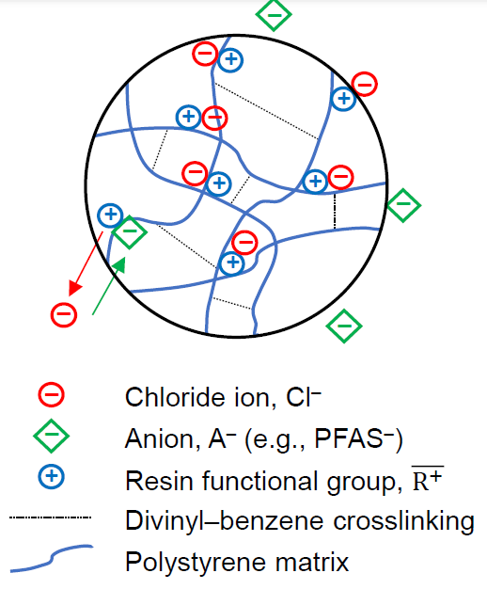
Anion Exchange
Resins that attract PFAS molecules
PFAS have negatively charged ions
Resins are positively charged
Spent resin material will have high PFAS
Pilot study required before construction
Figure from Speth, Thomas, EPA Office of Research and Development. PFAS in Drinking Water: Centralized Treatment. Drinking Water Workshop: Small Systems Challenges and Solutions. September 14, 2023. PowerPoint Presentation.
Figure adapted from Lee et al. (2018) https://doi.org/10.3390/ma11040560
Notes:
The ion exchange resin has positively charged active sites. The resin is initially loaded with chloride anions (negative charge).
Other anions (in this case, PFAS) will exchange onto the active, positive sites. The chloride anions will be “kicked off” and released into the water.
This is another costly item, as PFAS-selective anion exchange resins are more expensive than GAC.

Slide 30
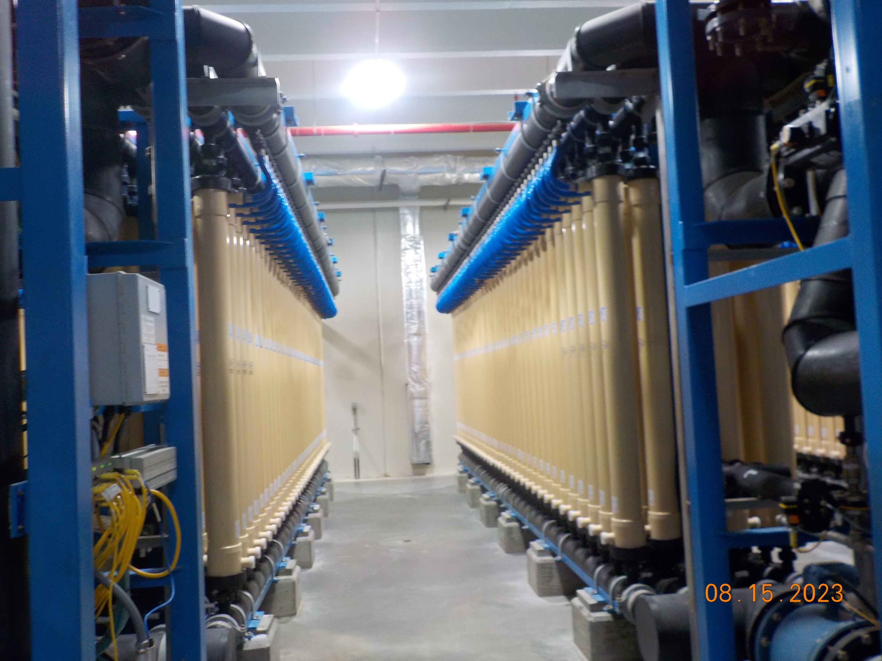
Membranes
Semipermeable barrier that lets water through but traps larger molecules like PFAS
Nanofiltration (NF)
Pore size = 0.001 – 0.01 µm
Reverse osmosis (RO)
Pore size = 0.0001 – 0.001 µm
Uses high pressure to force water through membrane
Liquid waste stream will have high PFAS
Some utilities have processes to make a super concentrated liquid waste stream that is more cost effective for disposal
Pilot study required before construction
Notes:
- It should be noted that ultrafiltration (UF) and microfiltration (MF) membranes are not mentioned on this slide because when compared to NF and RO membranes, they are not as efficient at removing short-chained PFAS

Slide 31
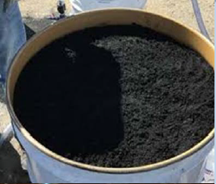
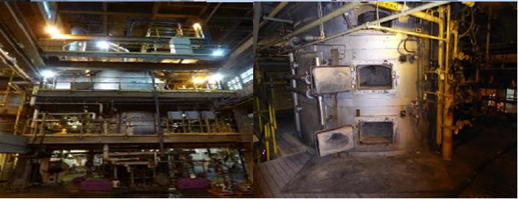
Where does the waste go?
GAC
Research being done on re-activation of spent carbon
Anion Exchange Resin
Incineration
Landfill
Membranes
Most difficult to deal with due to the highly concentrated waste stream that is produced
Figures from Speth, Thomas, EPA Office of Research and Development. Managing PFAS Treatment Residuals. Drinking Water Workshop: Small Systems Challenges and Solutions. September 14, 2023. PowerPoint Presentation.
Notes:
- During the EPA’s Small Systems Drinking Water Workshop in September 2023, the EPA stated that they were actively looking for partners for sampling of cement kiln incinerators. Cement kilns can reach gas temperatures of up to 2000 degrees Celsius.
Research is currently being done on GAC reactivation, which would involve taking the spent GAC media and exposing it to very high temperatures (>700 degrees Celsius).
There really are no cheap options for removal of PFAS from treatment residuals. All disposal methods are very costly.
Note- Currently the recommendation for disposal of AIX resin is incineration, as landfill leachability data isn’t fully available

Slide 32
Regionalization
Is regionalization an option?
Most treatments for PFAS are expensive $$$
It might be more cost effective to switch sources or purchase from a neighboring system
Notes:
Regionalization projects with another PWS are eligible for DWSRF assistance if it is the best alternative to treatment.
Extra priority is awarded to regionalization projects with a public health risk which PFAS qualifies as.

Slide 33
Drinking Water State Revolving Fund (DWSRF)
How can I get funding to help?

Slide 34
DWSRF Process
First step is to get on project priority list (PPL)
Funds are first awarded to shovel-ready projects
If there are multiple shovel-ready projects, funds are awarded according to placement on PPL
PFAS projects will likely need a pilot study approved by DEQ’s Construction Permitting Section to proceed
Notes:
An example letter for getting on the Project Priority List (PPL) is shown on the next slide. What it means to be “shovel ready” is discussed on the slide after that.

Slide 35
Capacity Development: EC-SDC Funds
Emerging Contaminants in Small and Disadvantaged Communities
Grant from EPA/BIL
Funding available to communities that are small and/or disadvantaged
Less than 10,000 population with focus on less than 3,300
System is determined disadvantaged by DEQ income guidelines
Can fund sampling for program and aid in treatment costs for systems
Partnered with DWSRF funds
Notes:
EC-SDC is a project that is being headed up by Capacity Development. It is designed to help small and disadvantaged systems with PFAS and the new regulations.
BIL grant money given to DEQ. Focus will be on disadvantaged systems less than 3,300 and systems that have positive samples for PFAS or other emerging contaminants such as manganese.
Goal of program is to help systems that cannot afford treatment costs and to obtain a better understanding on the prevalence of emerging contaminants in Oklahoma.

Slide 36
Questions? Water quality help line 405-702-8100
Notes:
If you have any questions going forward, reach out to your compliance coordinator or district engineer. If you are unsure, the water quality helpline at 405-702-8100 can direct your call.

