Slide 1
Area wide optimization Program

Slide 2
overview
What is AWOP?
AWOP in Oklahoma
Regions
Recent Workshop
CPEs
Awards
Contact Info

Slide 3
What is awop?
Began in 1989
Goal was to optimize water systems in order to maximize public health protection
Initial focus was Turbidity and Disinfection By-Products (DBPs)
Now focuses on:
Turbidity
DBPs
Chlorine residual
Corrosion control
Ground water wells and treatment techniques
Distribution systems and storage tank integrity
Harmful Algae Blooms (HABs)
Manganese control
Nitrification

Slide 4
Awop in oklahoma
Ongoing since 1999
Began with an emphasis on CPE training
Strong history of management support
Voluntary “extra” role for staff
Not enforcement

Slide 5
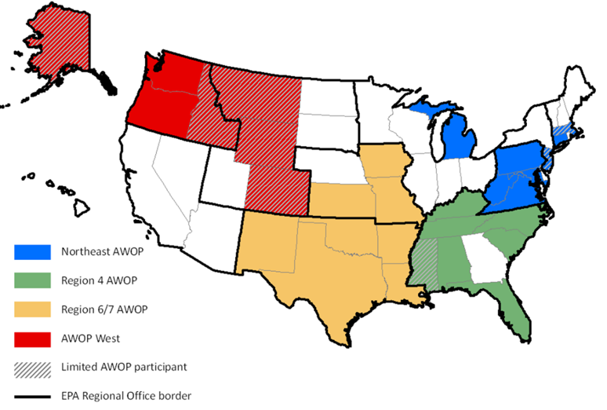
AWOP Regions

Slide 6
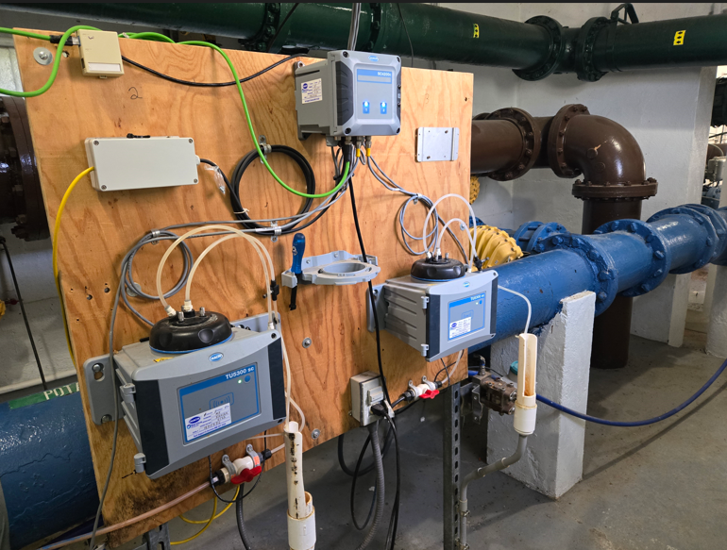
Turbidity workshop
Group 1
Reviewed sampling locations for raw, settled, IFE and CFE turbidity
Calculated detention times
Group 2
Maintenance frequency & SCADA
Group 3
Interpreting & Reporting Turbidity Data
Group 4
Benchtop vs. Continuous Turbidimeter Monitoring

Slide 7
Findings
Two locations had longer than 1 minute detention times
Raw samples from settled troughs instead of top of clarifier
Have access turbidimeter settings
Data capping at 1 NTU
Omit backwash events in SCADA system
Purchase vial cleaning gel to remove fingerprints
Purchase turbidity standards
Calibrate benchtops regularly

Slide 8
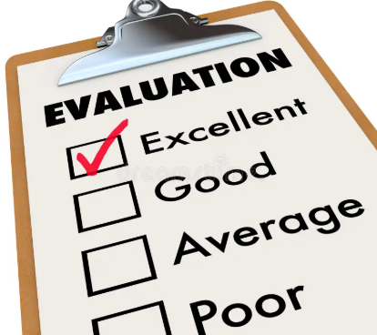
Comprehensive performance evaluation (CPE)
Sanitary Survey
Focuses on performance limiting factors
Financial
Organizational
Operational
How system treats water
Usually triggered by high turbidity
Centers around filtration

Slide 9
AWOP AWARDS
Encourages optimization by recognizing Public Water Supply Systems participating in the AWOP AWARDS Program

Slide 10
AWOP AWARDS Participation
Optional to participate
Start collecting data for awards beginning January 2019
If interested, stay after the presentation to provide contact information to be placed on the participation list
DEQ will schedule a meeting with you at your water system to explain the process and go over forms to be submitted

Slide 11
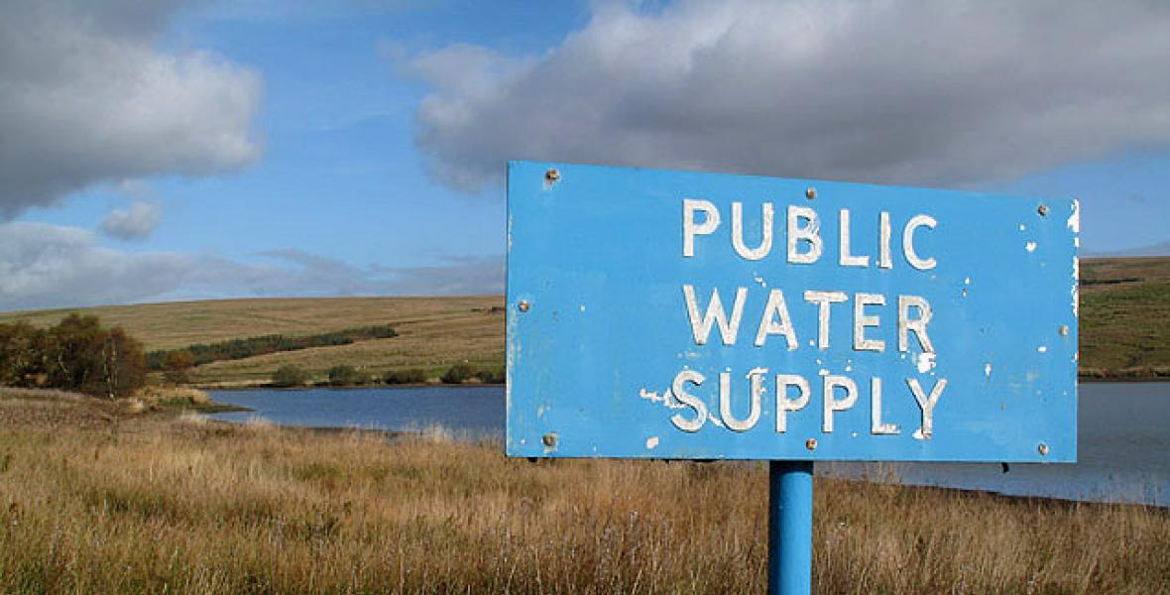
Who can participate?
Any Oklahoma Public Water Supply System
Awards divided into 3 categories
Surface Water/Groundwater under the direct influence of surface water (SW/GWUDI)
Groundwater (GW)
Purchase water (PW)

Slide 12
How are awards determined?
Criteria with various point values to be applied to each water system
Scores for each participating system will be determined on an annual basis
Example criteria:
Turbidity, IFE and CFE (SW/GWUDI)
Monitoring
Capacity Development Assessment
Water Loss Audit
MCL violations
And a few more

Slide 13
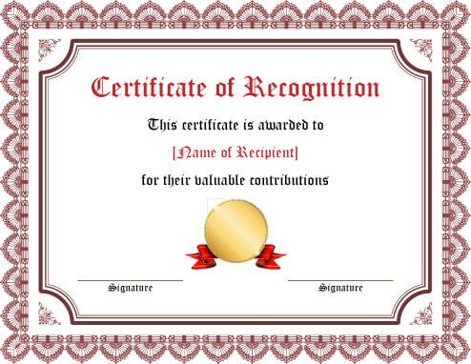
The awards
Flag for top system in each category
Participation certificates for all participants
Special Certificate for top system in each category (SW/GWUDI, GW, and PW)
Top systems recognized (websites, newsletters, newspaper, etc.)
The proud feeling knowing that your water system is the most optimized in the state of Oklahoma!!

Slide 14
interested???
AWOP Coordinator
Candy Thompson, P.E.
(405)702-8233
candy.thompson@deq.ok.gov
CPE Team Lead
Tara Bussing
(405) 702-8189
tara.bussing@deq.ok.gov
Workshop Team Leads
Siobhan Gibbons
(405)702-8155
siobhan.gibbons@deq.ok.gov
Andrew Shaw, E.I.
(405)702-8244
andrew.shaw@deq.ok.gov

Slide 15
conclusion
What is AWOP?
AWOP in Oklahoma
Regions
Recent Workshop
CPEs
Awards
Contact Info

Slide 16
Questions???

