Slide 1
Manifesting
Multi-copy document tracking hazardous waste from leaving generator to reaching offsite TSD.
Required for all hazardous wastes shipped offsite with some exemptions.
Generator’s responsibility to ensure correct and complete information.
Keep manifests for at least 3 years.

Slide 2
Manifesting
Exemptions
CESQG wastes
Waste reclaimed under contractual tolling agreement
Need to meet qualifications
Universal wastes (fluorescent lamps, batteries, mercury-containing waste)
Used oil
Hazardous wastes exempted from RCRA:
Scrap metal
Lead-acid batteries to be reclaimed
When not shipped on manifests, keep any records, such as receipt, bill of lading, etc. to prove these wastes are shipped to right facilities.
Notes:
Waste reclaimed under contractual agreement:
The reclaimer come to pick up the waste, reclaim it at their site, return the reclaimed waste to you
There must be an agreement btw the generator and reclaimer. In agreement, identify the type of waste and the frequency of the shipment
The vehicle used to transport the waste and reclaimed waste between your facility and the reclaimer must be owned and operated by the reclaimer
Keep a copy of the agreement at your facility for at least 3 years after the termination of the agreement

Slide 3
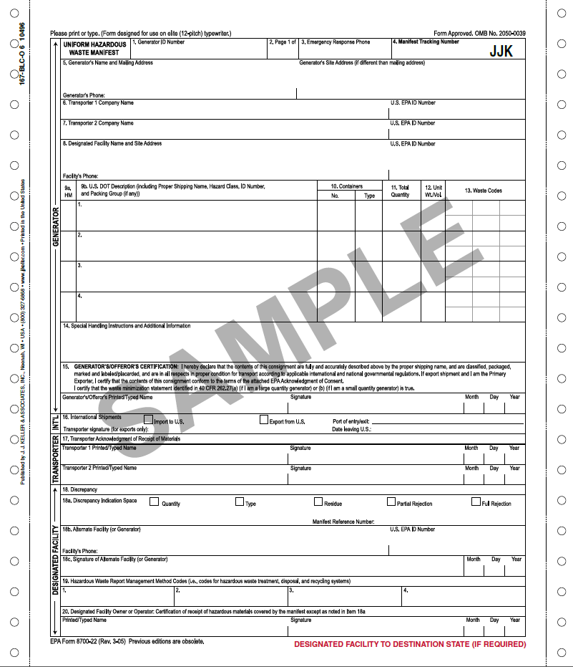
Manifest Page 1
Manifesting

Slide 4
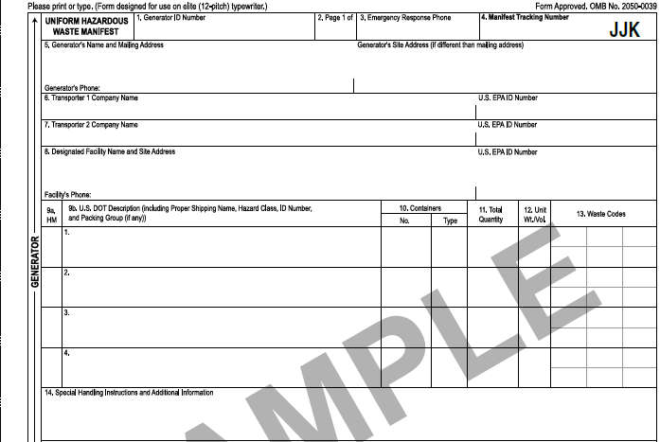
Manifesting
Manifest Page 1
Working 24/7
Unique and preprinted
X
Waste corrosive liquid, basic, inorganic (sodium hydroxide), 8, UN3266, PG II
D002
1
DM
55
G
X
Waste paint related material, 3, UN1263, PG III
4
DM
220
G
D001 D035 F003 F005 D007 D005
Mark X if hazardous
Six most representative codes
Specific information of each waste (optional)
Notes:
Instruction is on the back of each manifest

Slide 5
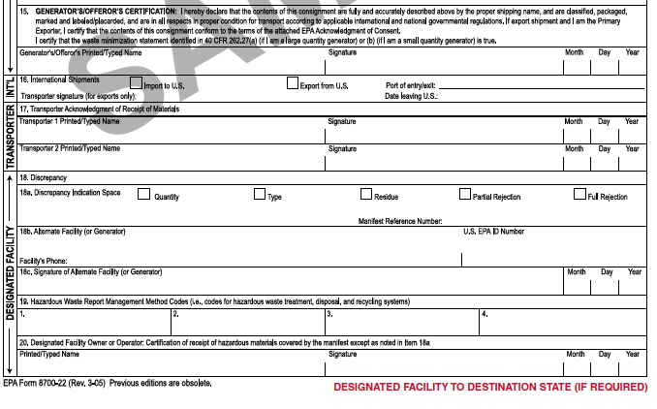
Manifesting
Manifest Page 1, continued
Any additional manifest used to track rejected waste
If the entire load is rejected:
Alternate TSD your wastes are shipped to, or your facility (generator)
Management code for each waste in box 9b
H121
H141
Must receive TSD-signed copy in 60 days.
45 days: contact TSD;
60 days: notify DEQ.

Slide 6
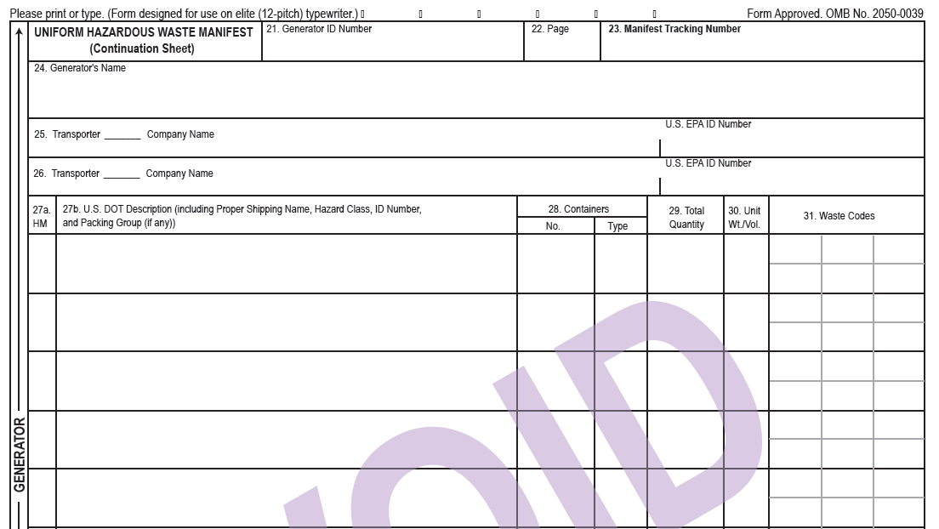
Manifesting
Manifest continuation page
Must type in or hand write the # shown on page 1
3
4
D001
X 05. waste flammable liquid, 3, UN1993, PG II 1 DM 55 G

Slide 7
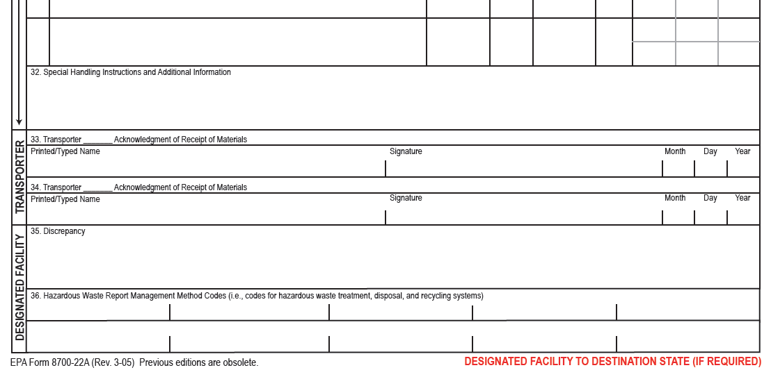
Manifesting
Manifest continuation page, (continued)
05 H061

